Slide 1
Health-adjusted disparities in maternal mortality
Andy Yuan
University of Florida Levine College of Law

Slide 2
Overview
Sources of racial and ethnic disparities in maternal mortality: differences in health versus differences in quality of maternal care
New evidence published in a medical journal
Focus on implications on policy and institutional design
Khiara Bridges, Racial Disparities in Maternal Mortality, 95 N.Y.U. L. Rev. 1229 (2020)

Slide 3
Conceptual framework
Health disparities: focus on health outcomes
Important to understand the sources
  Targeted intervention
  Accountability
Maternal mortality
  Federal legislation
  Difference in underlying health versus differences in quality of care
  Guidance for policy interventions

Slide 4
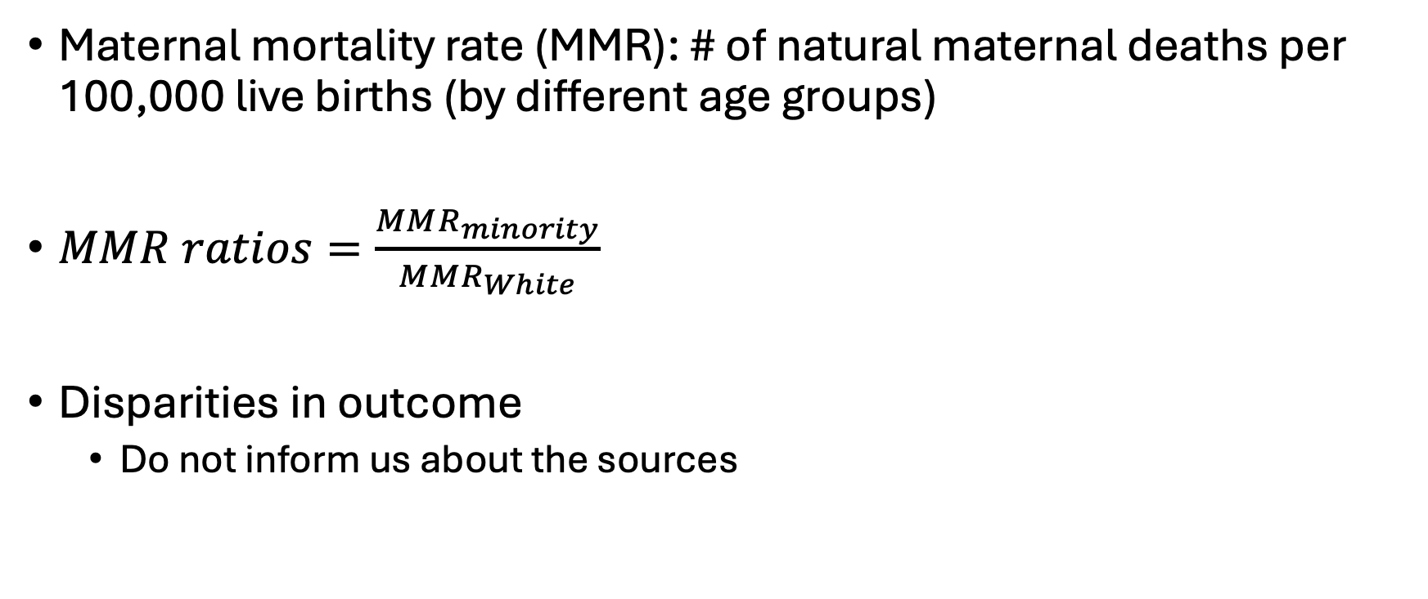
Evidence: overall disparities in maternal mortality
Maternal mortality rate (MMR): # of natural maternal deaths per 100,000 live births (by different age groups)
$MMR ratios=\frac{MMR_{minority}}{MMR_{White}}$
Disparities in outcome
  Do not inform us about the sources

Slide 5
Evidence: overall disparities in MMR

Slide 6
Evidence: differences in health
Non-maternal natural mortality rate: # of non-maternal natural deaths per 100,000 population

Slide 7
Evidence: health-adjusted disparities in MMR
Raw disparities in MMR
Health-adjusted disparities in MMR

Slide 8
Policy implications: access to care
Unequal access to adequate maternal care
Obstetric unit closures in rural area
  “Rural maternity care crisis”
  Relocated to hospitals of higher quality
  Empirical evidence
Role of torts
  Locality rule, unable to resolve inter-hospital differences in care quality

Slide 9
Policy implications: Medicaid
Differences in health explains raw disparities in MMR
Medicaid: public health insurance program for the poor
Large empirical literature showing positive return of Medicaid on health, maternal health
Additional justification for investing more in Medicaid

