Slide 1

Birth Justice Lawyering
Jamille Fields Allsbrook, JD/MPH
Assistant Professor
of Law
Howard University School of Law

Slide 2
Related Publications
Regulating for Birth Justice, 29 Lewis & Clark L. Rev. 649 (2026).
Birth Justice Lawyering, Loyola Chicago University Annals of Health Law & Life Sciences (forthcoming Summer 2026).

Slide 3
Movement Building

Slide 4



Movement Her-story
Mothers, Pregnant and Birthing People
Midwives and Doulas
Community-Based and Supporting Coalitions
Funders

Slide 5
- Pregnancy Justice
“[We] seek to ensure that ‘birth justice’ is fully incorporated into the reproductive justice movement. This occurs when the goals of reproductive justice fully address and incorporate not only women’s ability to make decisions about whether and when to have children, but also about how they are treated during the critical times of labor and childbirth.”
(formerly National Advocates for Pregnant Women)

Slide 6
Other Movements
Reproductive Justice
Maternal-Child Health
Pronatalism

Slide 7
Birth Justice in Practice

Slide 8
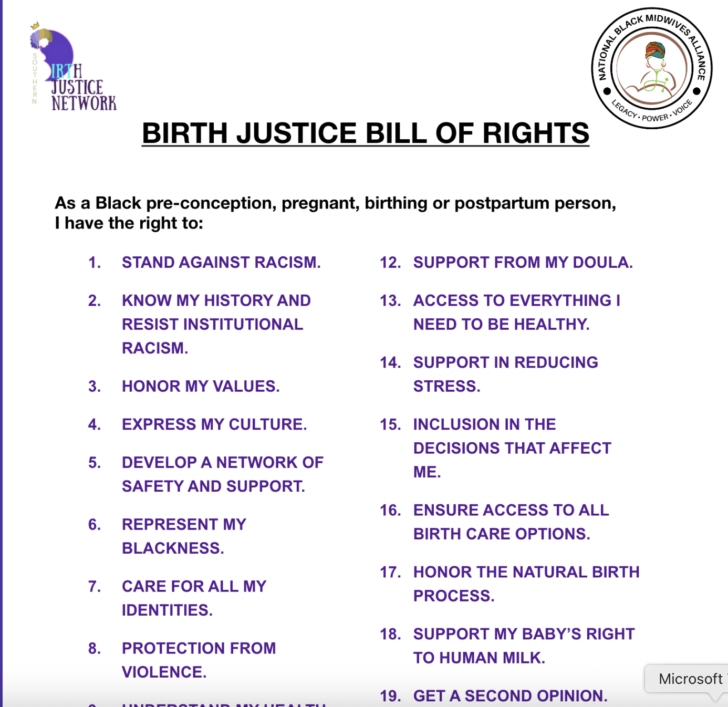
- Southern Birth Justice
“Birth Justice includes the right to choose when, where, how, and with whom to birth, including access to traditional and indigenous healers, such as midwives and other birth workers, and the right to breastfeeding support. The complete range of pregnancy, labor, and birth options should be available to everyone as an integral part of reproductive justice. These are our rights as mothers and parents. ”

Slide 9
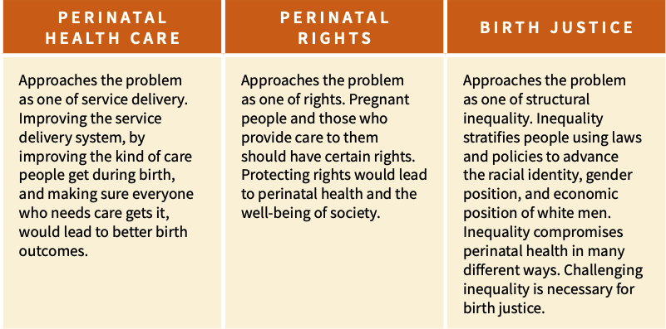
- Birth Justice Association

Slide 10
“How we achieve birth justice is just as important as what we achieve.”
- Elephant Circle

Slide 11
Birth Justice in Action
What it is not and
how not to get there
  Centering providers
  Overmedicalization and defensive medicine
  Ignoring pain
  Restrictive licensing
  Limited insurance coverage
  Barriers to provider training
  Coercive practices
What it is and
how to get there
  Community and individual-led priorities
  Maternal health focused
  Antiracist, intersectional
  Comprehensive care throughout pregnancy and a year postpartum
  Promoting natural births and/or reducing overmedicalization
  Access to a broad range of services, providers and birthing support
  Care for the caretakers
  Nonjudgmental

Slide 12
Movement Lawyering
Community led
Lawyer accountability to the movement
Law as a tool, not the goal
Integrated advocacy

Slide 13
An Analysis of Federal
Maternal Health Legislation

Slide 14
PMDA & IAMCA
 | Provisions | Missing
Preventing Maternal Deaths Act | Support MMRCs Disseminate best practices on maternal mortality prevention to hospitals, state-based professional societies, and perinatal quality collaboratives | Adequate funding structure Solutions Review standards Racial analysis Accountability
Improving Access to Maternity Care Act | Require HRSA to identify maternity care health professional shortage areas Assign maternity care health professionals to those areas Require HRSA to collect and publish data comparing availability of and need for services in HPSA | Access to certain providers and birthing support Racial Analysis

Slide 15
 | Provisions | Missing
American Rescue Plan | Creates state option to extend Medicaid postpartum coverage Requires states extending Medicaid postpartum coverage to include full scope of Medicaid covered services | State Requirement Robust coverage extension

Slide 16
 | Provisions | Missing
The Momnibus Act | Extend WIC eligibility Funding for CBOs Funding to improve care for veteran moms Invest in perinatal workforce Mental health conditions and substance use disorder support Invest in digital tools and innovative payment models Grants for climate impacted moms and babies and programs during public health emergencies Task force on social determinants of health Promote maternal vaccinations Improve maternal health research | Accountability Access to the full range of providers and birthing support Insurance Coverage An adequate funding structure Robust focus on social drivers

Slide 17
Thank you!

