Slide 1
Fat Might Be Fabulous: Challenging Conventional Wisdom On American Health Law & Policy
35 Cornell J.L. & Pub. Policy 1-46 (2026)
ASLME Health Law Professors Conference
Gail Brennan, Steve Calandrillo & Eli Cooper-West

Slide 2
The Low-Fat Diet
Conventional dietary wisdom vilifies saturated fat
”Fat makes you fat” = “Common Sense”
But Correlation is NOT causation
X: does eating ice cream cause gun violence?
Ancel Keys diet-heart hypoth: 7 Countries Study: cherrypicked; Crete during Lent; Mediterranean Diet
Recent studies debunk (Rob Krauss, Berkeley 2010): show positive effects of some saturated fats; shows refined carbs & transfats are bad (white bread, chips, crackers, pastries, sugary cereals)

Slide 3
Regulations Encourage Dubious Low-Fat Diet
U.S. has taken the bait and adopted the low-fat diet into laws and regulations:
  (1) USDA nutrition guidelines: Food Pyramid
  (2) Congress Farm subsidies => grains↑
  (3) National School Lunch Program; only skim or low fat milk
  (4) Facilitating pharmaceuticals for heart disease rather than considering dietary changes.

Slide 4
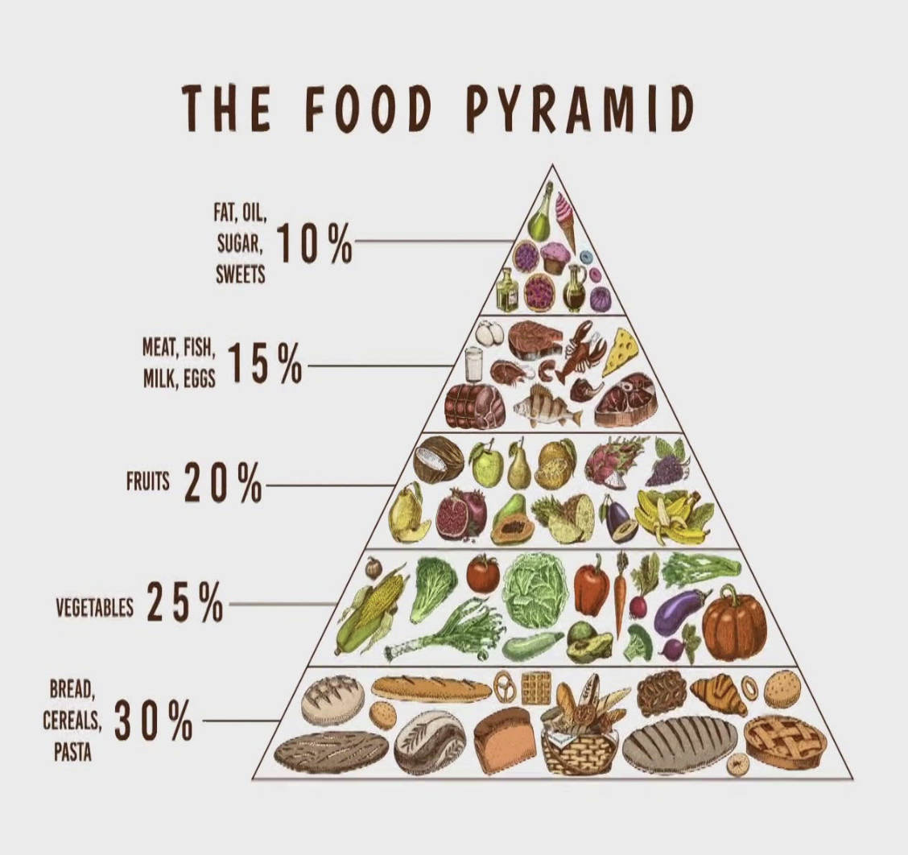
1. Direct Promotion of the Low-Fat Diet
USDA Dietary Guidelines
  Food Pyramid 1992; MyPlate 2011
  6-11 grains; 2-3 meat, cheese, milk; Fat at top
  Worse than sugar is “lean red meat”
These recommendations have not improved U.S. health (heart disease & obesity way up).
Notes:
Image: https://www.13newsnow.com/article/life/food/food-pyramid-history-what-happened-to-it/291-c65333a0-719f-4cce-8d33-e9b5cc46704e

Slide 5

2. Outdated and Harmful Farm Subsidies
U.S. agricultural subsidies are not aimed at benefitting the health of Americans.
  benefitted industrial farming
  Overproduce commodity crops (82% acres are corn, wheat, soybeans => hi fructose corn syrup, wheat into white flour, veg oil; sugar)
  Q: Result? Decreased price of processed carbohydrates and sugars, rather than promoting production and consumption of healthy saturated fat and organic food. (eggs, milk, beef)
Notes:
Image: https://www.istockphoto.com/photos/industrial-farming

Slide 6
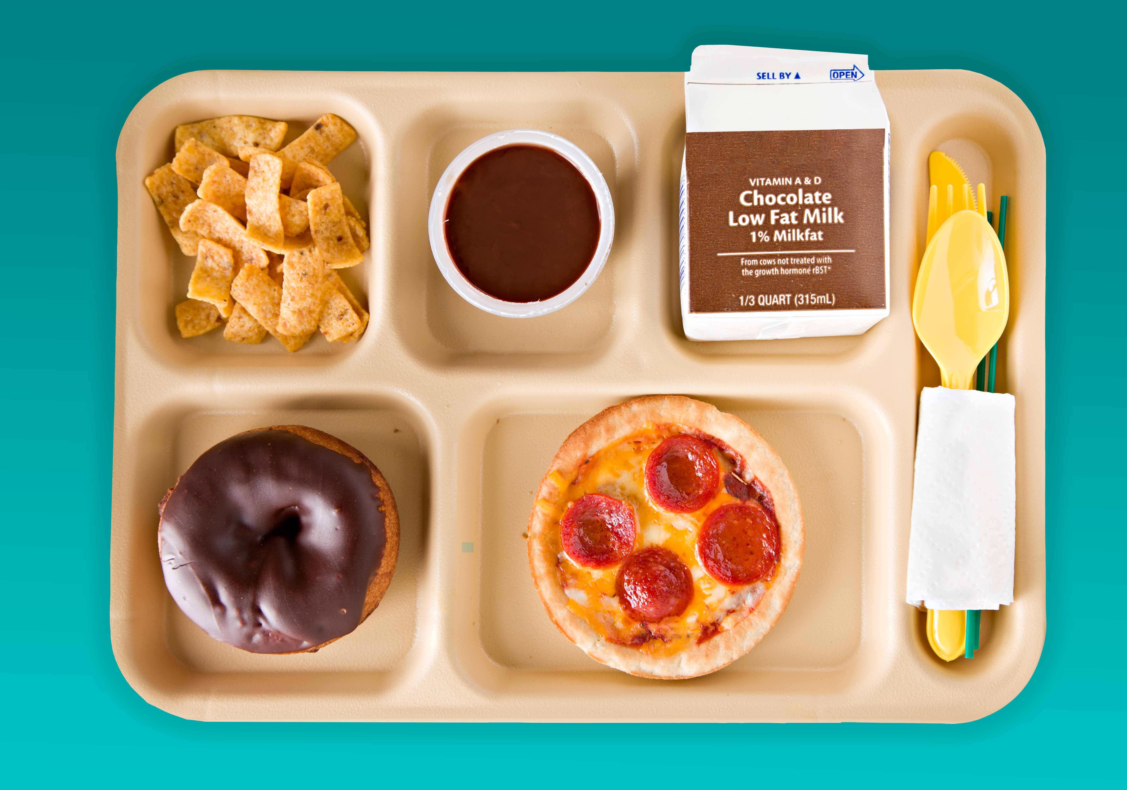
3. National School Lunch Program
Focus is on using available foods, not on a balanced diet for kids
  consumption of commodities (grains), and misguided focus on low-fat
  X: only low fat/skim milk until 2025 (Trump), but low-fat chocolate milk was OK; French fries = veggie
  School district subsidies conditioned on complying with federal requirements.
  Result is increased grain consumption and refined carbs/sugar > whole milk?!
Notes:
Image: https://www.pcrm.org/news/health-nutrition/usda-proposes-potentially-harmful-changes-school-lunch

Slide 7
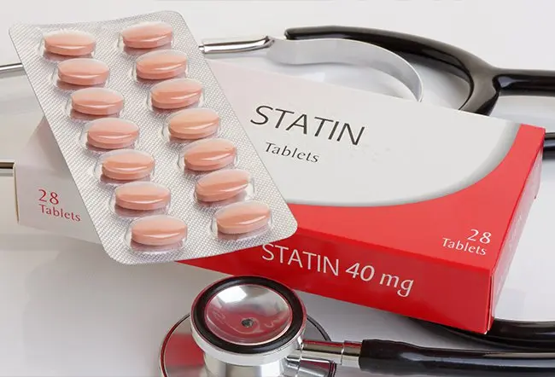
4. Drugs Over Diets
Growing heart disease
Result is a dramatic rise in pharmaceutical treatments.
1/3 of Americans take a statin or GLP1, generating $100 billion in annual revenue for pharmaceutical companies.
May be unnecessary and potentially harmful when dietary changes should be first.
Cut out refined carbs, ultraprocessed foods, and sugar (soda, sweets).
Notes:
Image: https://www.rxlist.com/statins/drug-class.htm

Slide 8
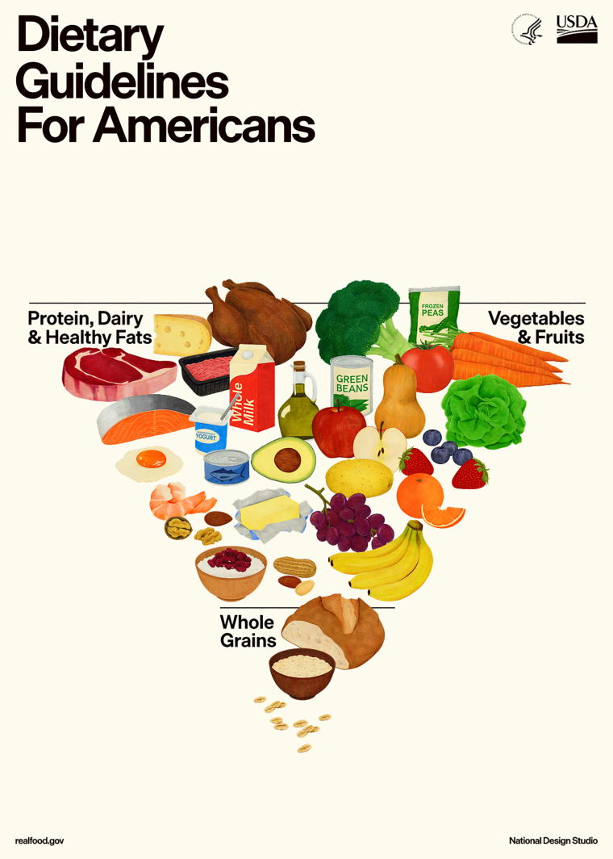
Call To Action: Embrace the Science
Science-backed dietary recommendations.
  Recognize benefits of saturated fat and harms of grain overconsumption.
Farm subsidies to increase the availability of healthy foods.
  Encourage sustainable organic farming
School lunch programs focused on healthy children.
  Prioritize nutrition rather than consumption of overproduced foods.
Dietary changes before drugs.

Slide 9
Conclusion
Heart disease has been the leading cause of death in the U.S. since 1921.
Early scientific leaders allowed their egos to influence their conclusions, vilifying saturated fat with insufficient basis.
This flawed science has infiltrated our laws and policies and therefore our own nutrition.
Health outcomes have not improved.
It is long overdue to revisit the low-fat diet and consider what is best for Americans, adapting our health law and policy to follow suit.
Allow certain fats to be fabulous.

Slide 10
