Slide 1
Ultraprocessed Food:
Does the Tobacco Model Fit?
Carl H. Coleman
Associate Dean for Graduate Programs and Professor of Law
Seton Hall Law School
Newark, N.J.

Slide 2
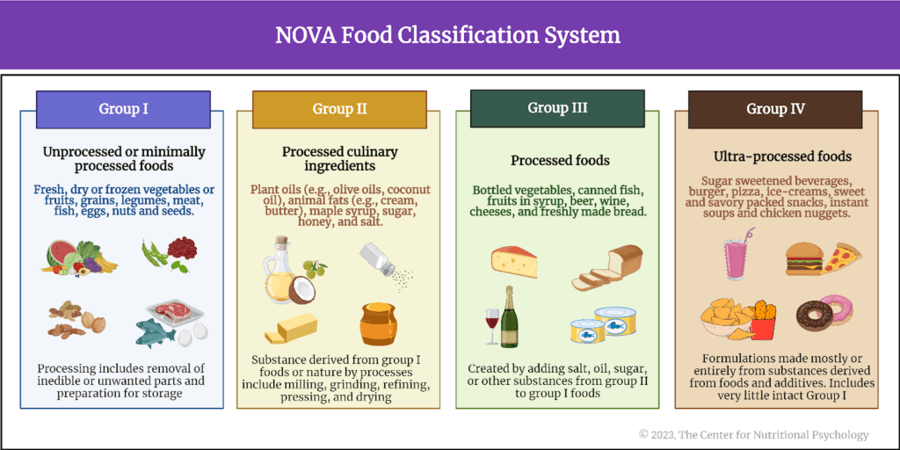

Slide 3
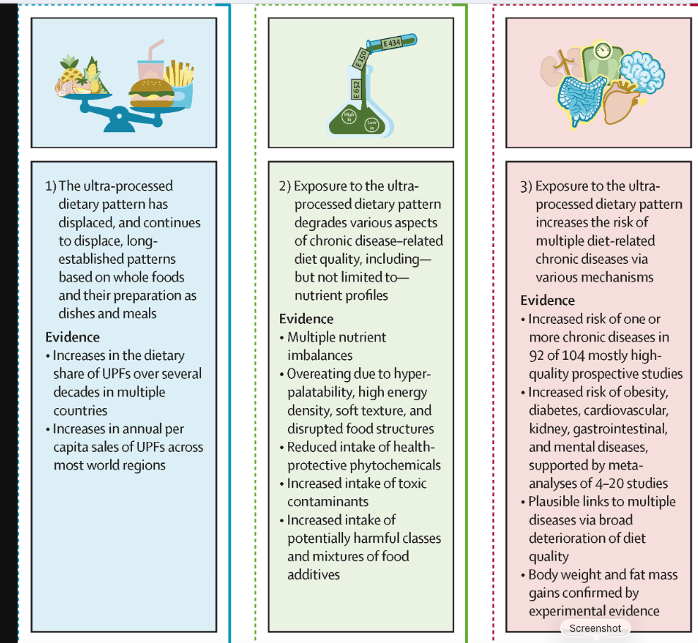
“The totality of the evidence supports the thesis that displacement of long-established dietary patterns by ultra-processed foods is a key driver of the escalating global burden of multiple diet-related chronic diseases.”
Carlos A. Monteiro et al., Ultra-Processed Foods and Human Health: The Main Thesis and the Evidence, Lancet, Nov. 18, 2025

Slide 4


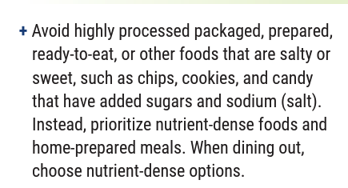


Slide 5
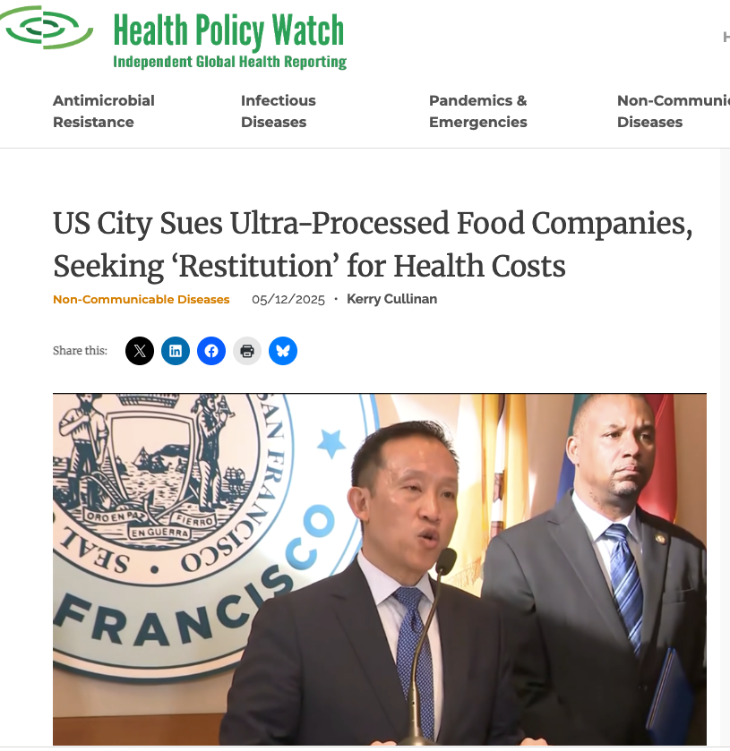
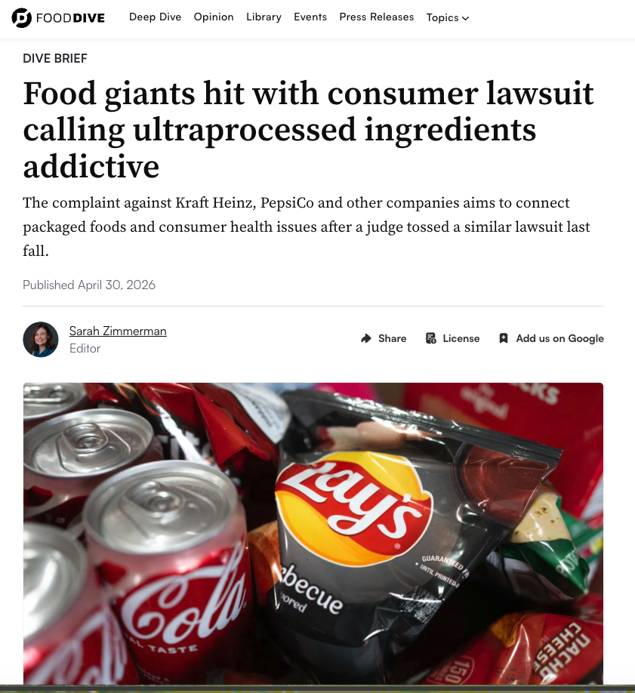
Notes:
SF lawsuit: alleges that the companies used “unfair and deceptive acts” to sell and market their products, violating California’s Unfair Competition Law and public nuisance statute.
Consumer lawsuit: filed in ED Wisconsin; alleges that ultraprocessed foods are scientifically engineered to be addictive and that companies took a page out of the tobacco industry’s playbook when marketing them to children.

Slide 6
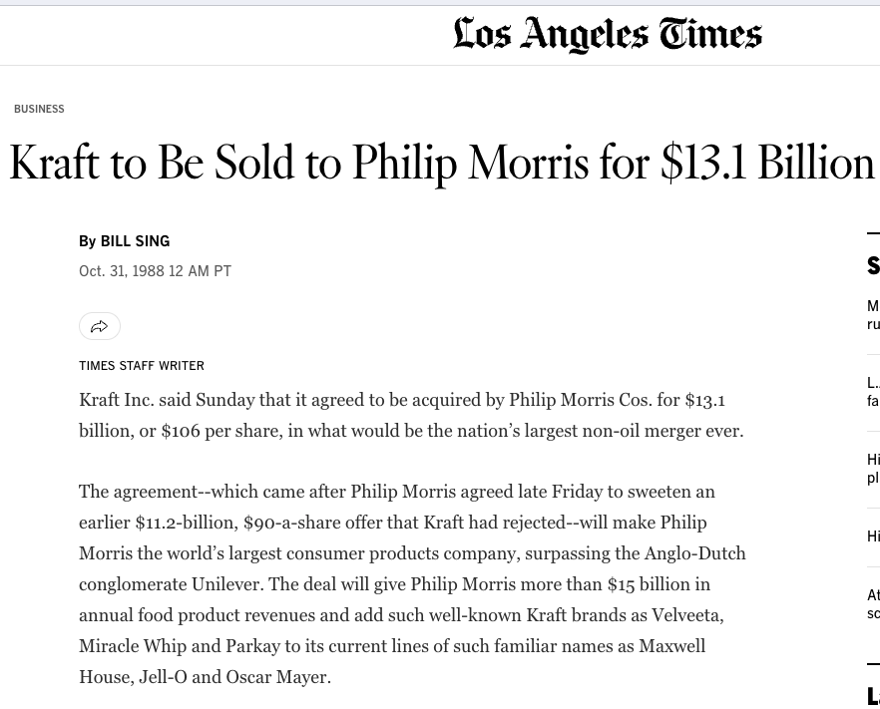
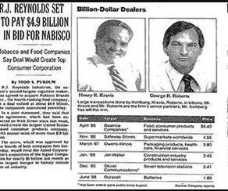
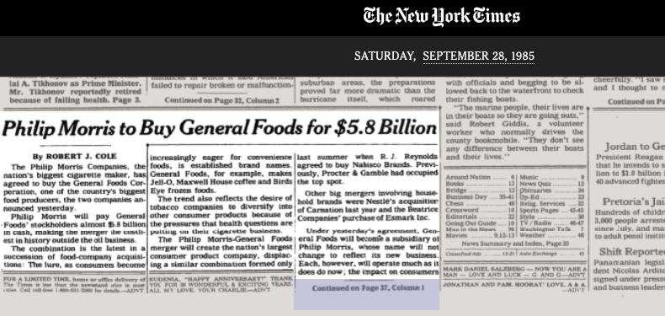
Notes:
In fact, the claim that food manufacturers have copied tobacco companies’ strategies is an understatement.
Big food isn’t just similar to big tobacco; for a key period in the development of UPFs, big food was big tobacco.
In the late 80s and 90s, many major food manufacturers were owned by tobacco companies, who purchased food companies as a means of diversifying and potentially improving their corporate image.
In other words, the companies developing and marketing UPFs and tobacco were exactly the same companies that had already hooked generations on cigarettes.

Slide 7
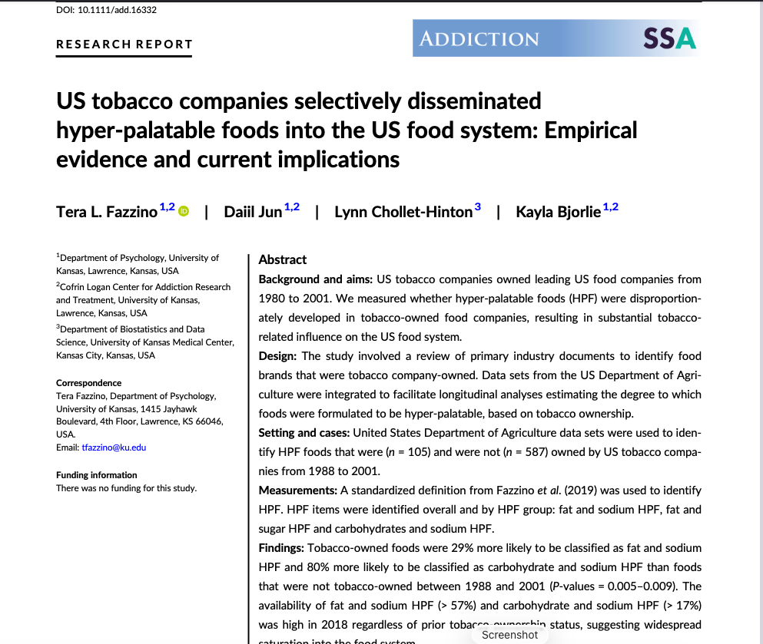
Notes:
And they seemed to be following the same playbook by formulating their products to be hyperpalatable and therefore more difficult to resist.
According to the study on the screen, tobacco-owned foods were 29% more likely to be classified as fat and sodium HPF and 80% more likely to be classified as carbohydrate and sodium HPF than foods that were not tobacco-owned between 1988 and 2001.
Tobacco companies began to spin off their food divisions in the early 2000s, when the association with tobacco began to hurt food companies’ business.
But food companies continued to implement the lessons they learned from their former owners and collaborators.

Slide 8
Why Processing Matters
When consumed in their natural or minimally processed state, the carbohydrates and fats in UPFs do not typically lead to overconsumption or carvings
The same is true of nicotine
    Naturally occurring nicotine in foods like eggplants and tomatoes does not lead to addiction because the concentrations are too small
    While tobacco leaves have higher levels of nicotine, overconsumption is unlikely because it leads to nausea and sickness
Processing increases the speed of delivery to achieve the maximum dopamine response
  Elements that could slow digestion, like fiber, protein, and water, are stripped away
The quick rewards are designed to fade quickly, leading to a desire for more
Notes:
“By breaking down the food matrix and enhancing bioavilability, UPFs could be considered ‘prechewed,’ ‘presalivated,’ and ‘predigested’ to enable the delivery of reifned carbohydrates and fats with enhanced speed and potency.”
Again, similar to cigarettes: designed to quickly deliver nicotine to the brain, creating intense pleasure that disappears quickly

Slide 9
Tobacco Control as a Model for Fighting UPFs
Tobacco’s downfall was based on evidence that companies deliberately engineered products to enhance their addictiveness
Successful efforts focused on limiting efforts to hook children, through marketing restrictions and limitations on access
Higher taxes on tobacco led to reduced consumption; similar evidence exists for taxes on sugar-sweetened beverages
Stronger warning labels can reduce demand without preventing access entirely
Notes:
Similarly, many state-level efforts are starting with UPFs in schools

Slide 10
But the Analogy Is Imperfect
UPFs exist on a spectrum; not all UPFs are equally bad
  2026 report by Healthy Eating Research recommends exempting foods that meet FDA “healthy” standard from definition of UPFs
The addictive potential of UPFs, while real, is lower than that of tobacco; many people consume UPFs in limited quantities
The causal connection between tobacco and harms like lung cancer and emphysema is clearer; the harms associated with UPFs are the result of multiple interrelated causal factors
Tobacco consumers are typically loyal to a single brand; most people consume multiple types of UPFs, making it harder to hold any single manufacturer responsible
Most advertising restrictions for tobacco were the result of the master settlement agreement; laws restricting UPF advertising will inevitably face a 1st Amendment challenge
Unlike cigarettes, food is a necessity; eliminating UPFs from schools and other settings will require replacing them with minimally processed alternatives
Notes:
HER report: “healthy” standard = minimum amount of food groups like whole grains or fruit/vegetables; no more than limited amount of added sugar, salt or saturated fat; no artificial sweeteners. Would cover about 10% of UPF breads and 43% of UPF tofu.
Conclusion: the comparison to tobacco is a useful framework for advocacy, but successful legal and policy measures to control UPFs can’t simply copy the anti-tobacco playbook.
Ultimately, what’s needed is broad change in our approach to food and nutrition, in which minimally processed foods are widely available and affordable and preparing and consuming real food becomes the cultural norm.

