Slide 1
Oh-Oh-Oh-Ozempic!
A Fifty-State Benchmark Plan Survey
Stacey A. Tovino, JD, PhD
John B. Turner Chair in Law
The University of Oklahoma College of Law
June 5, 2026

Slide 2

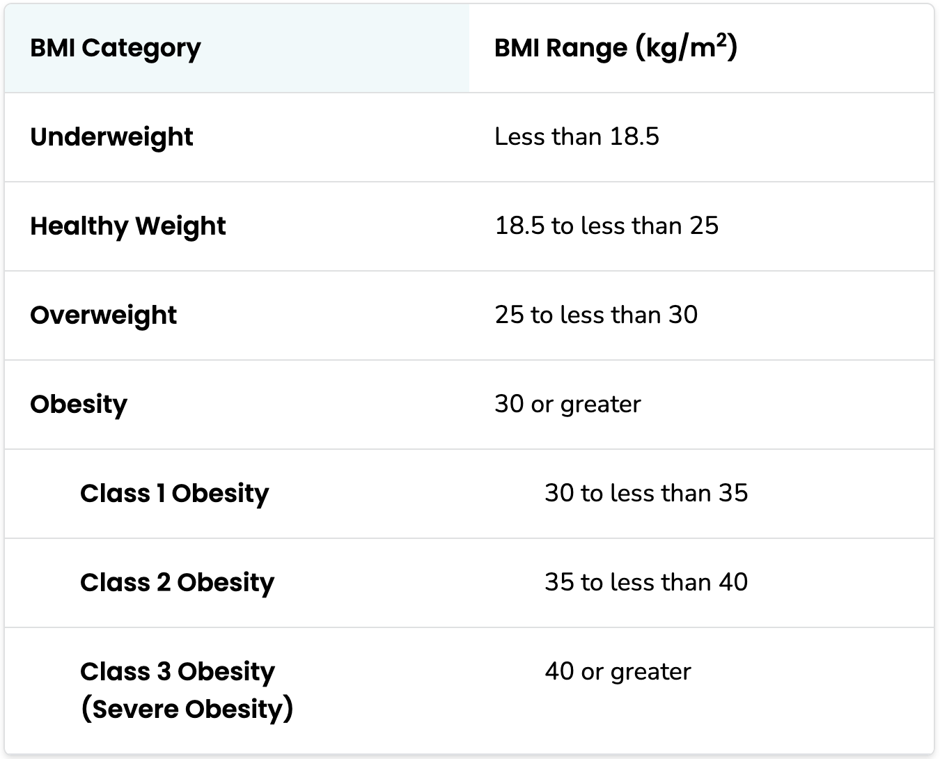

Slide 3
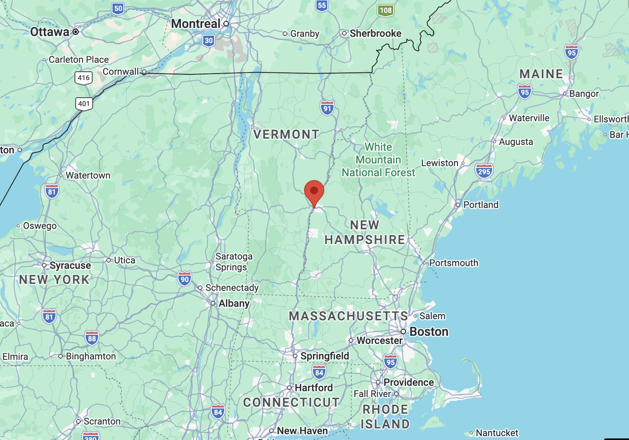

Slide 4
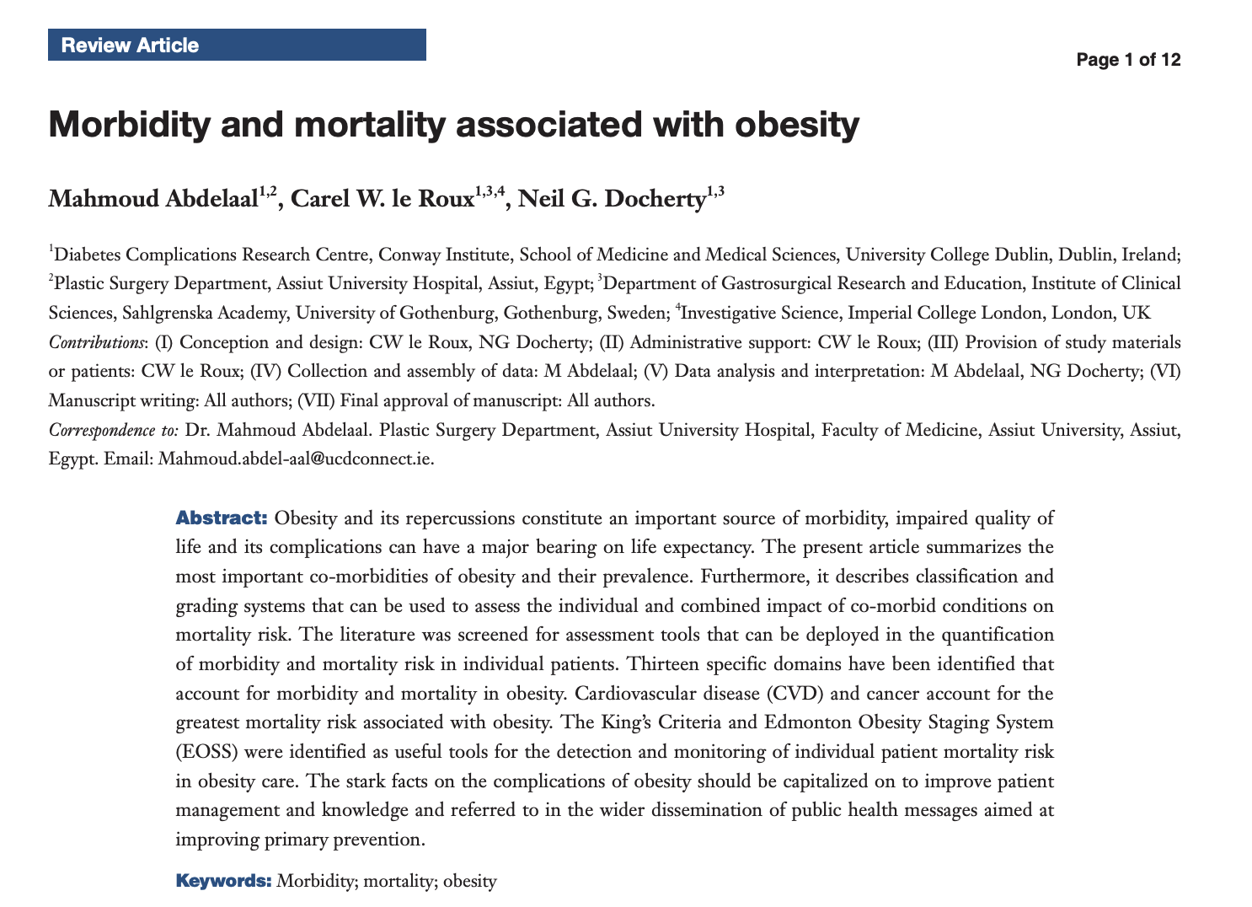

Slide 5

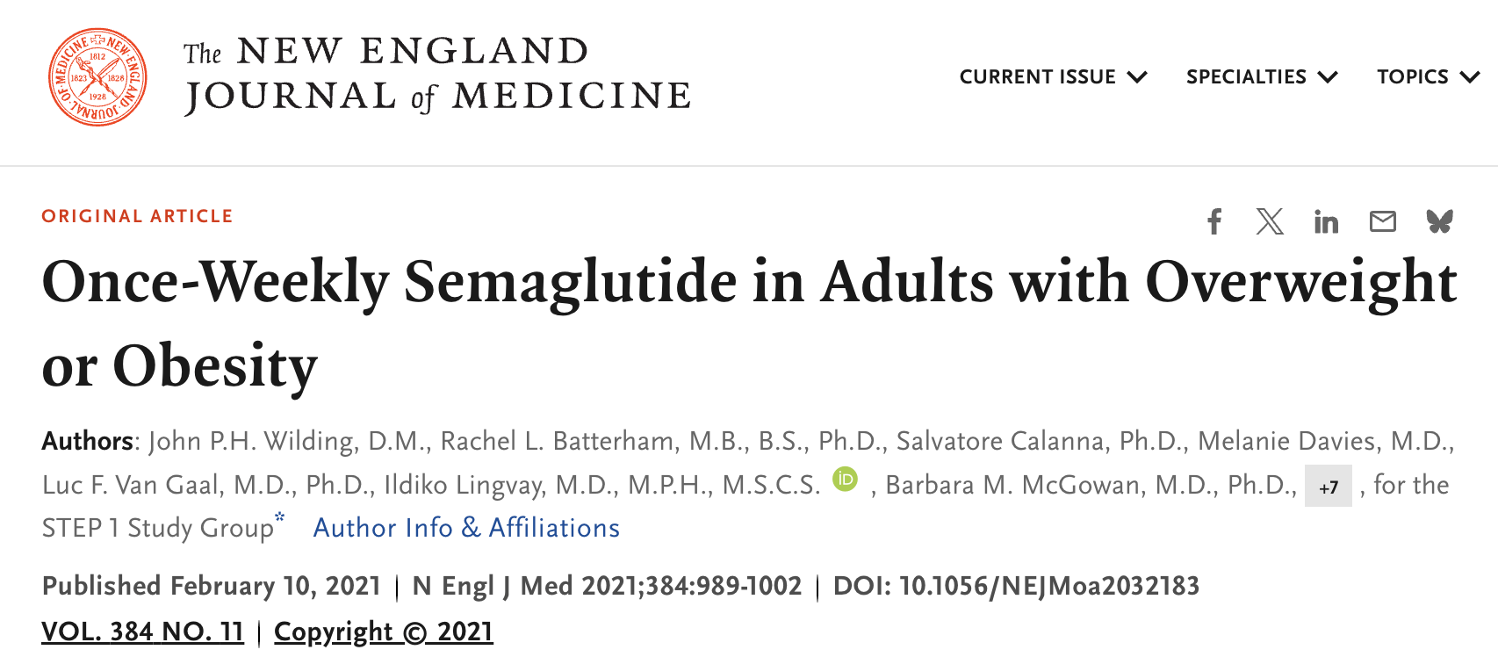
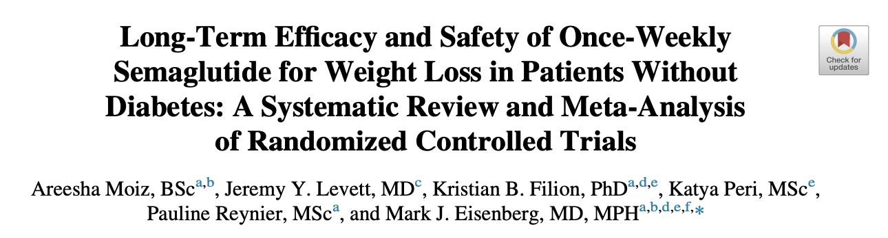

Slide 6
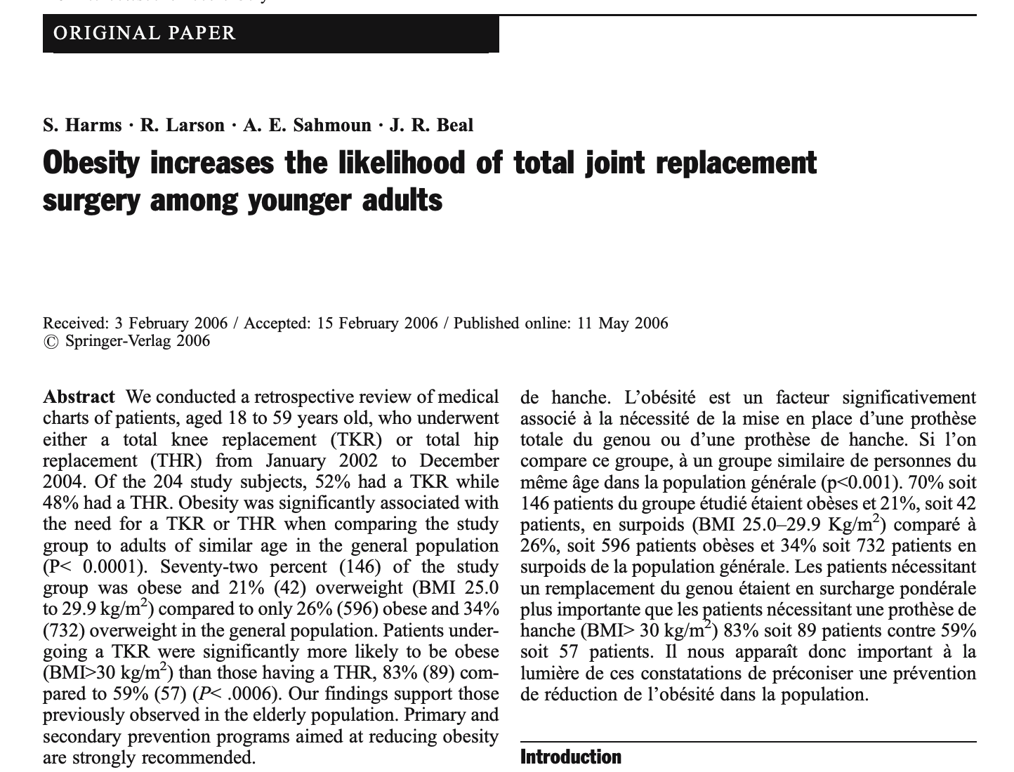

Slide 7
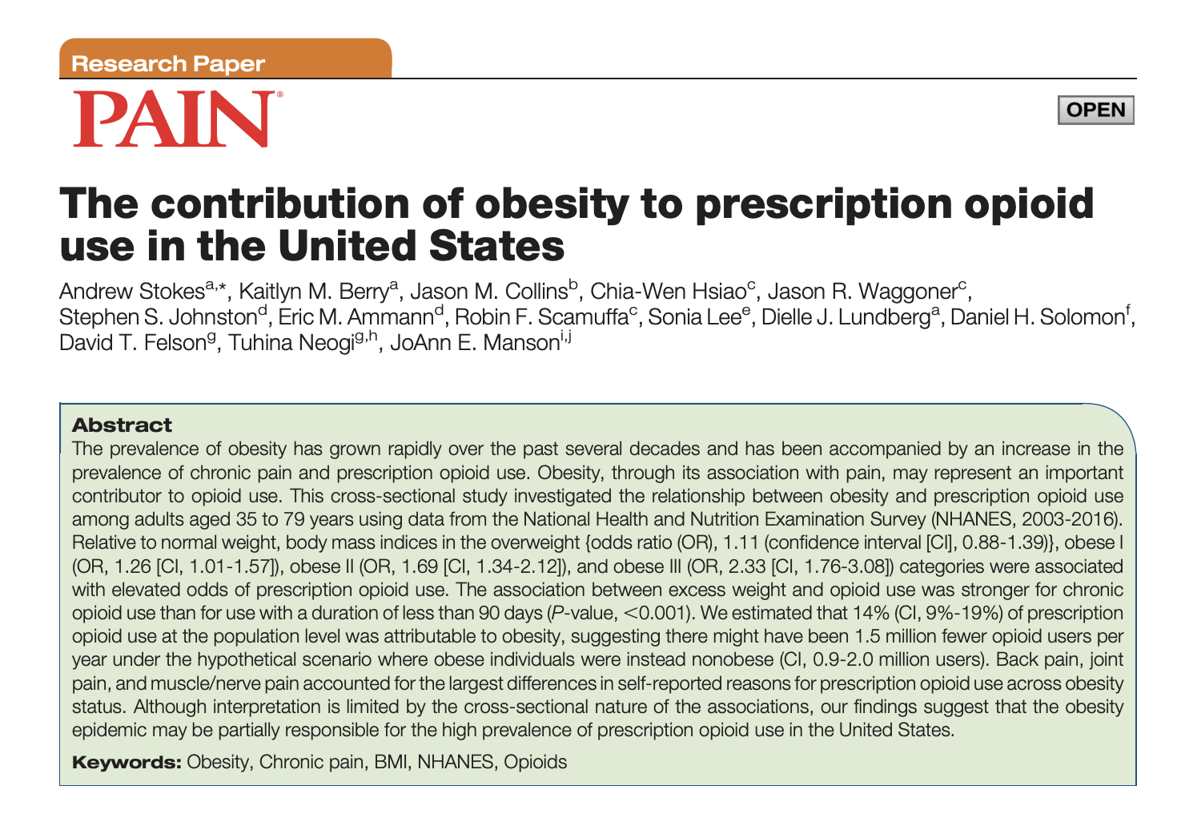

Slide 8
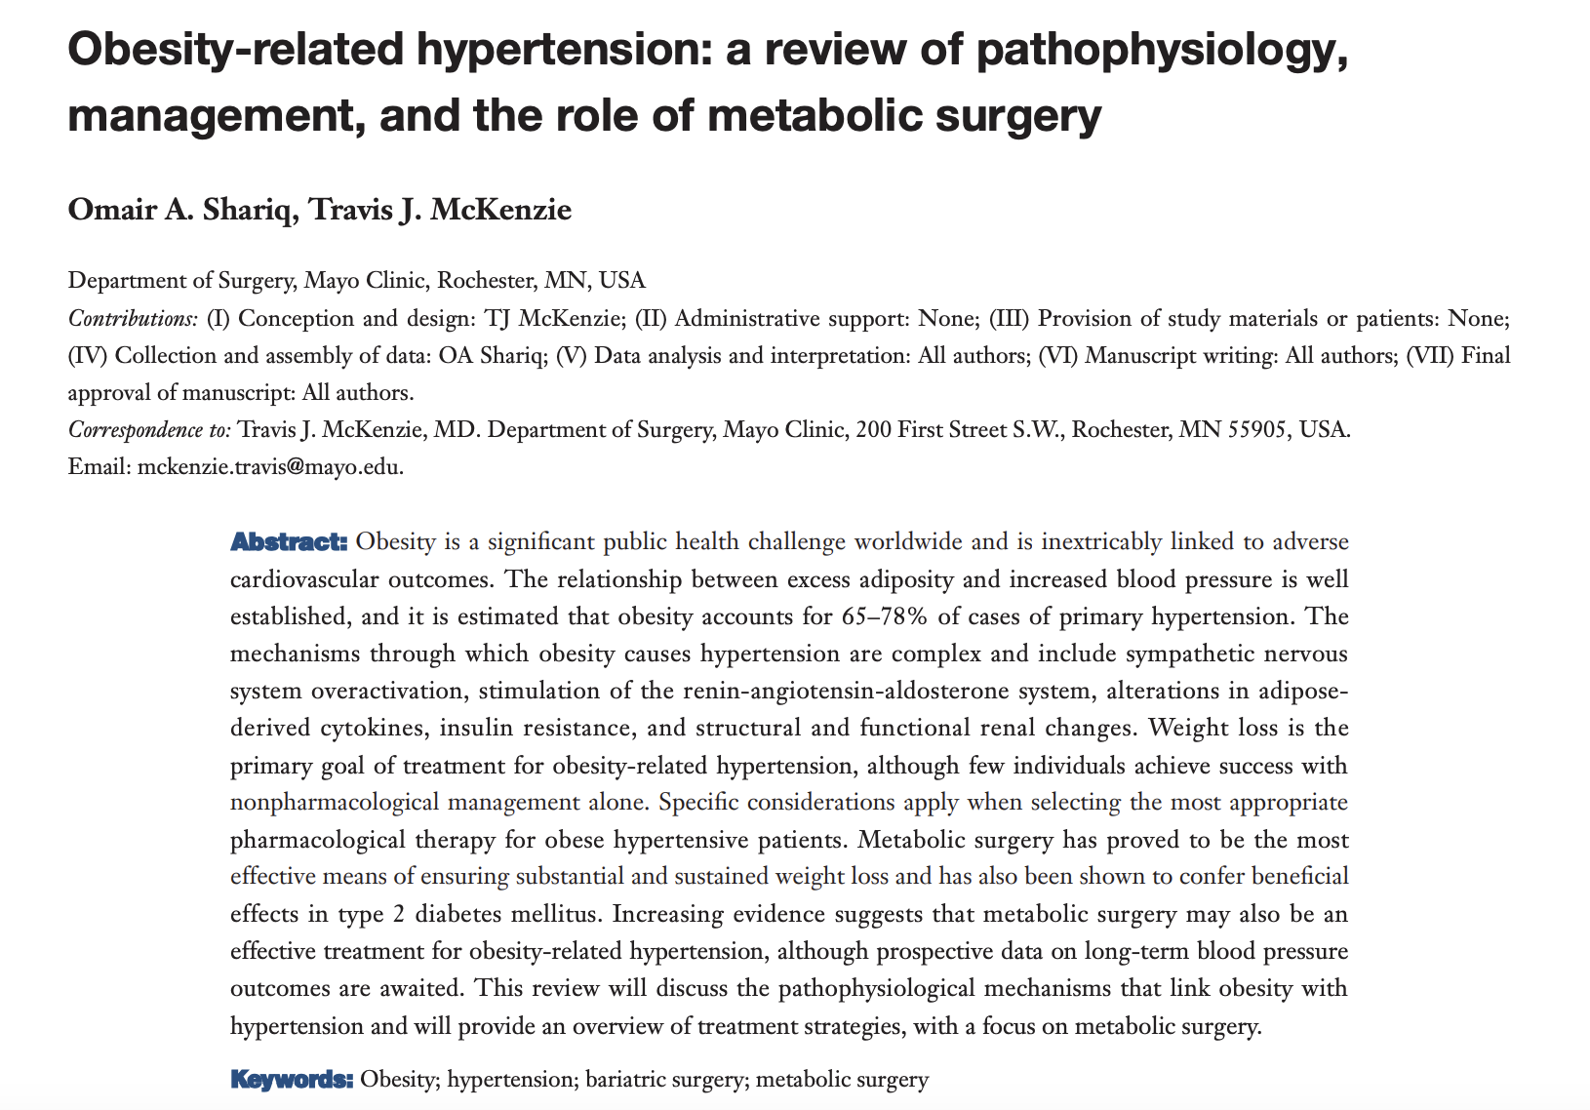


Slide 9
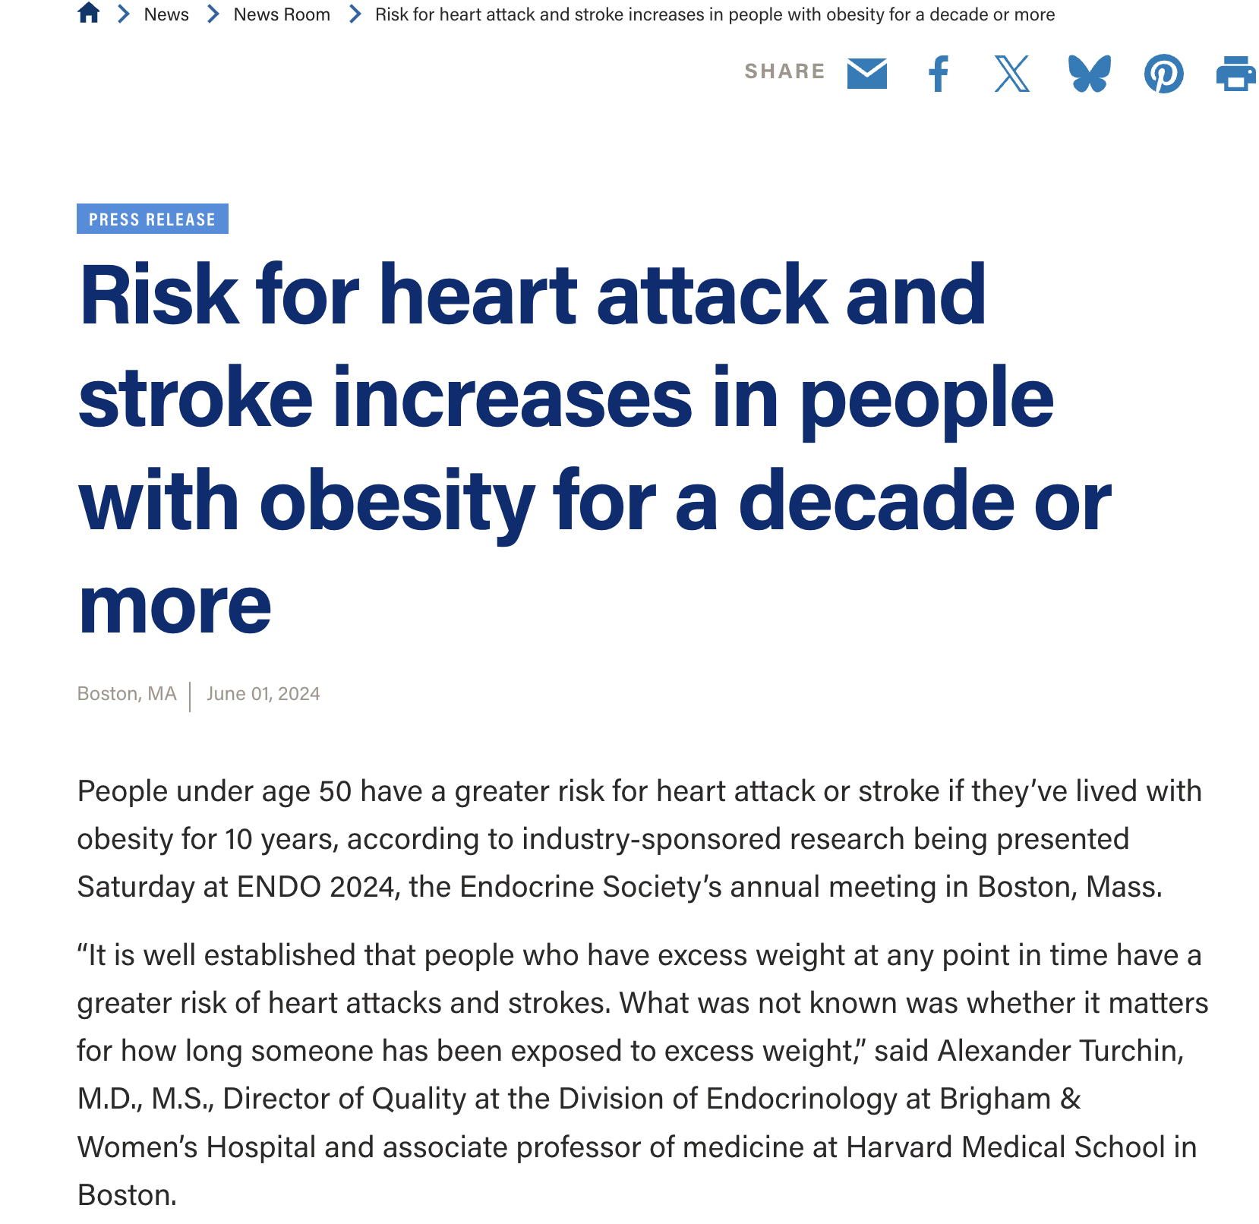

Slide 10
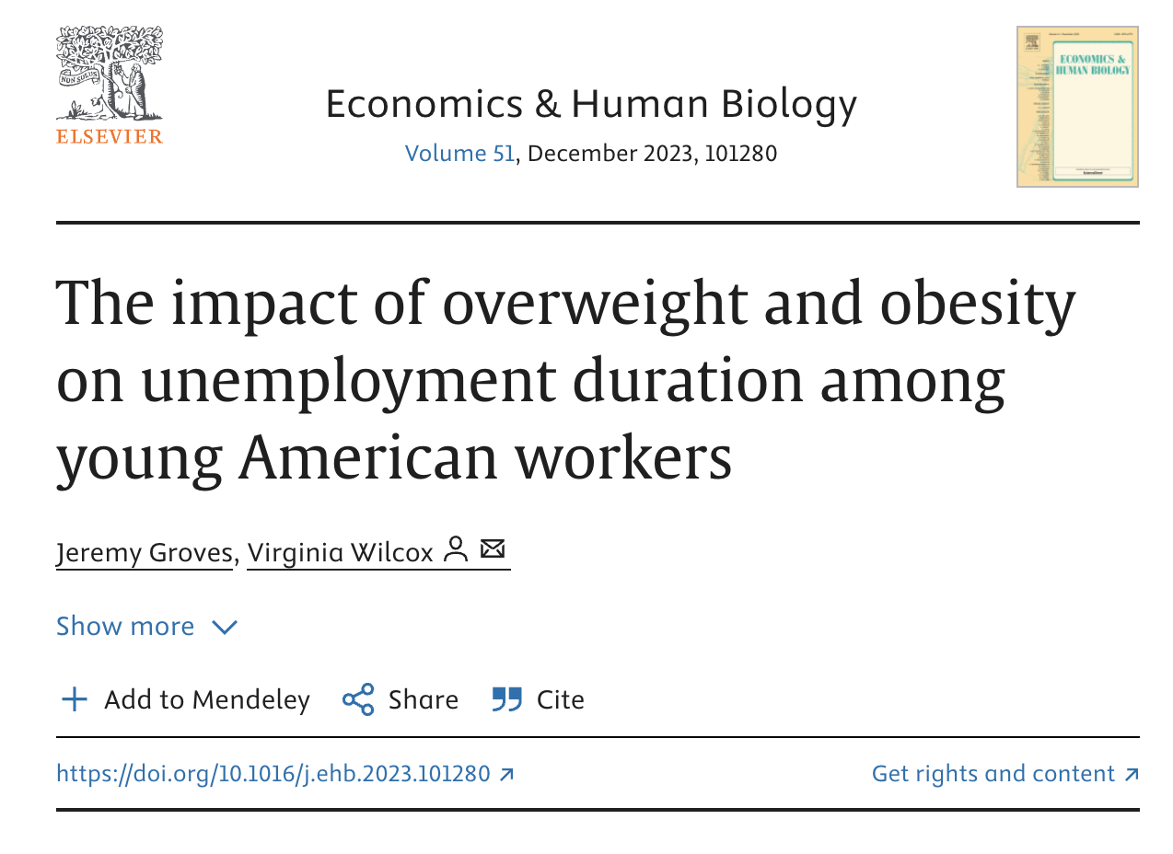

Slide 11
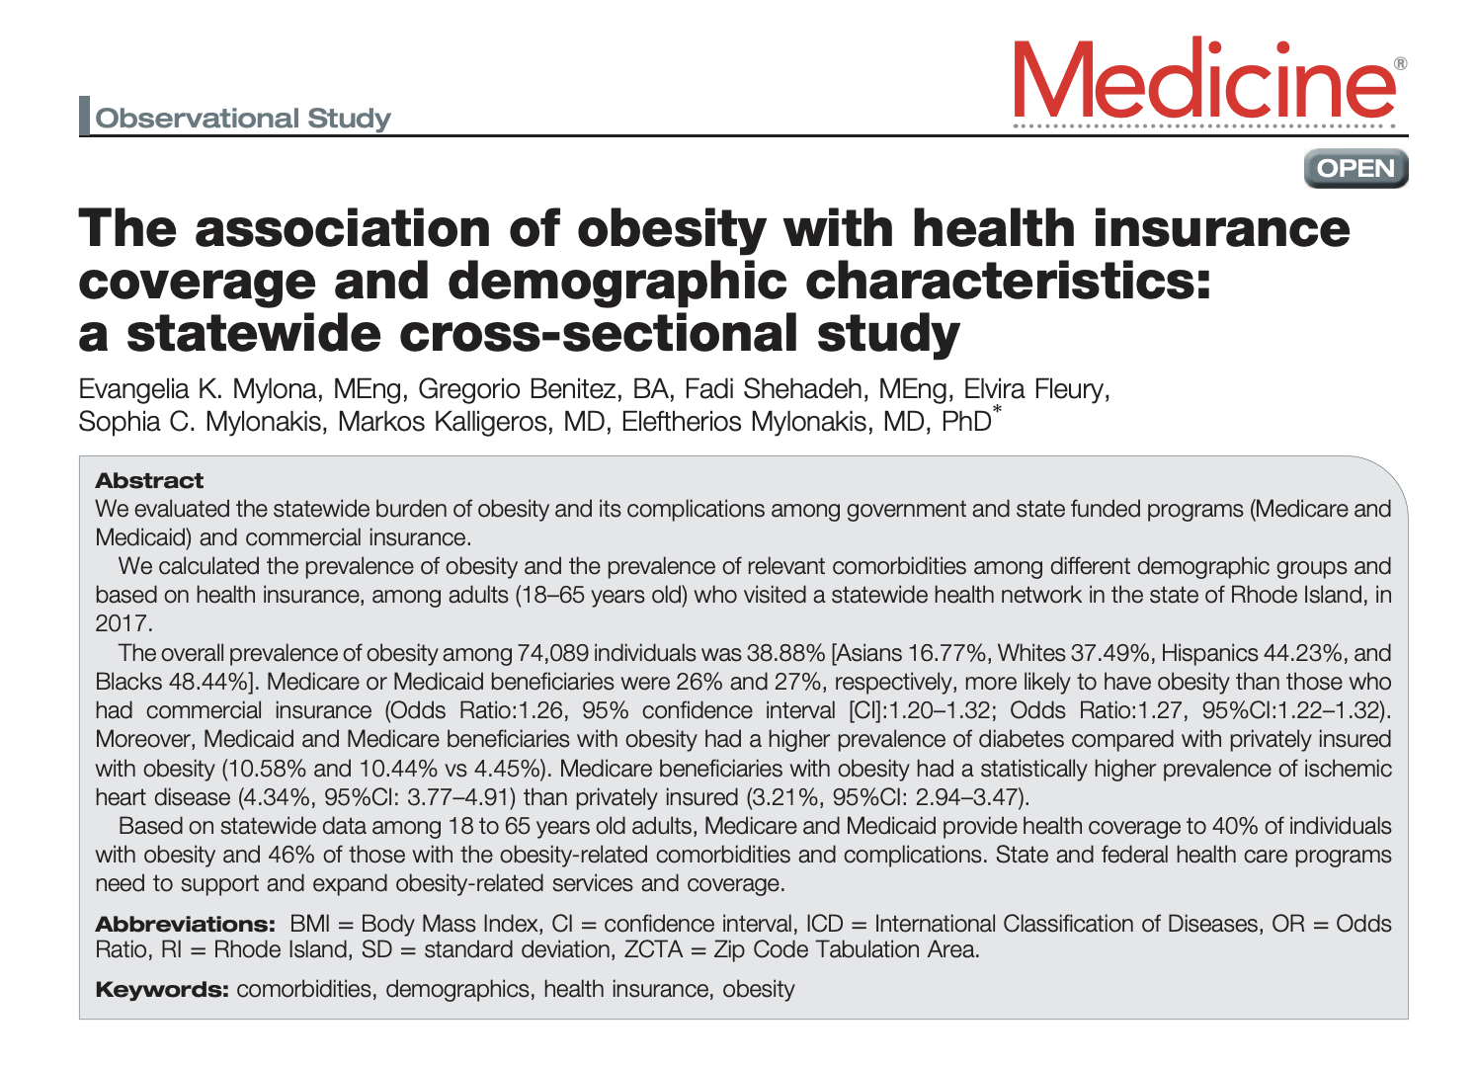

Slide 12


Slide 13
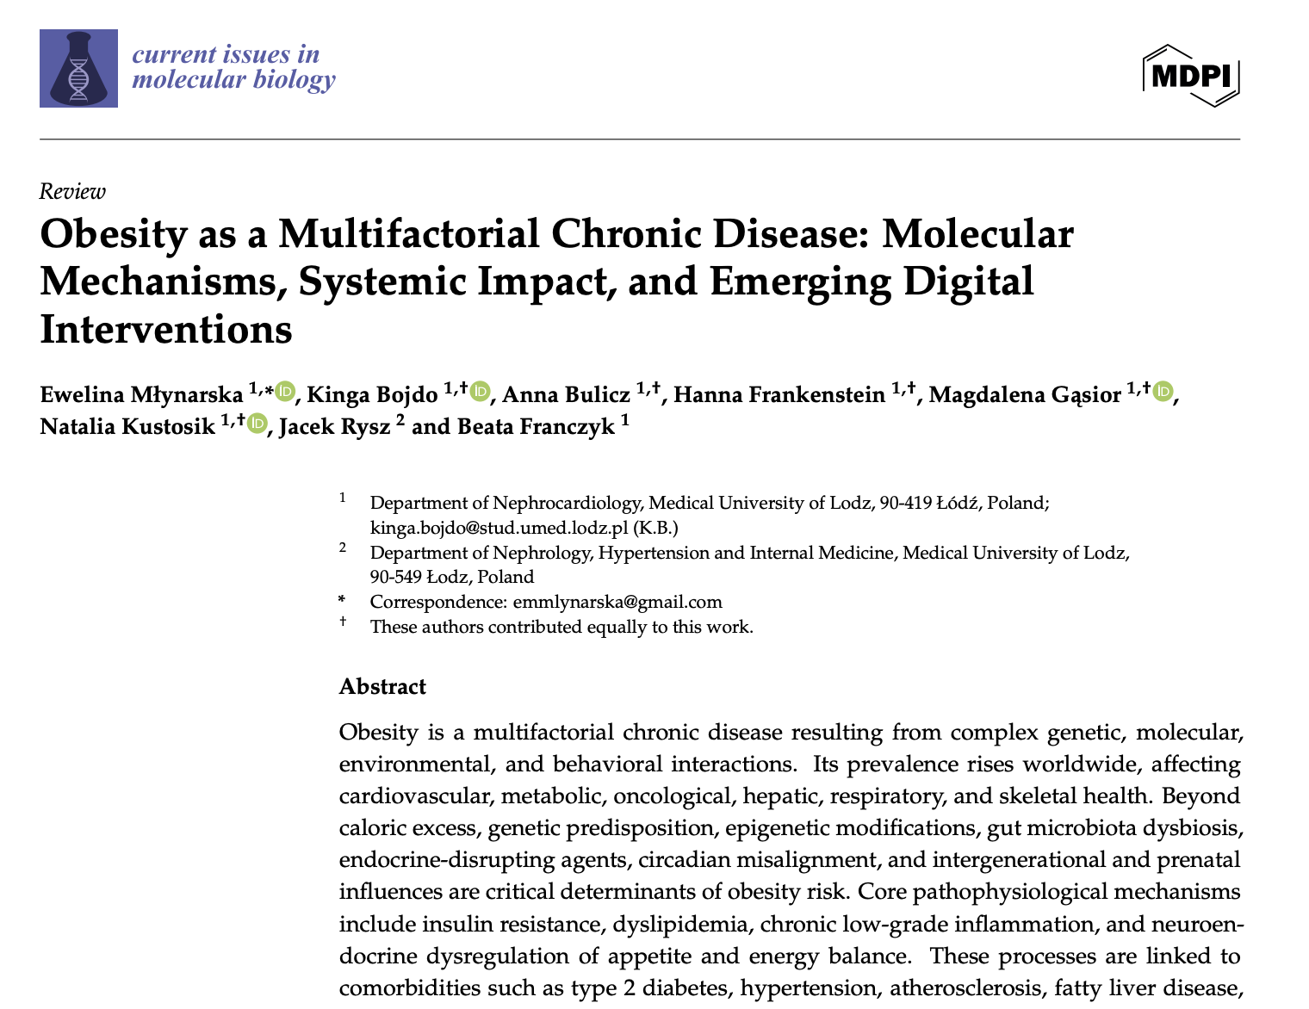

Slide 14
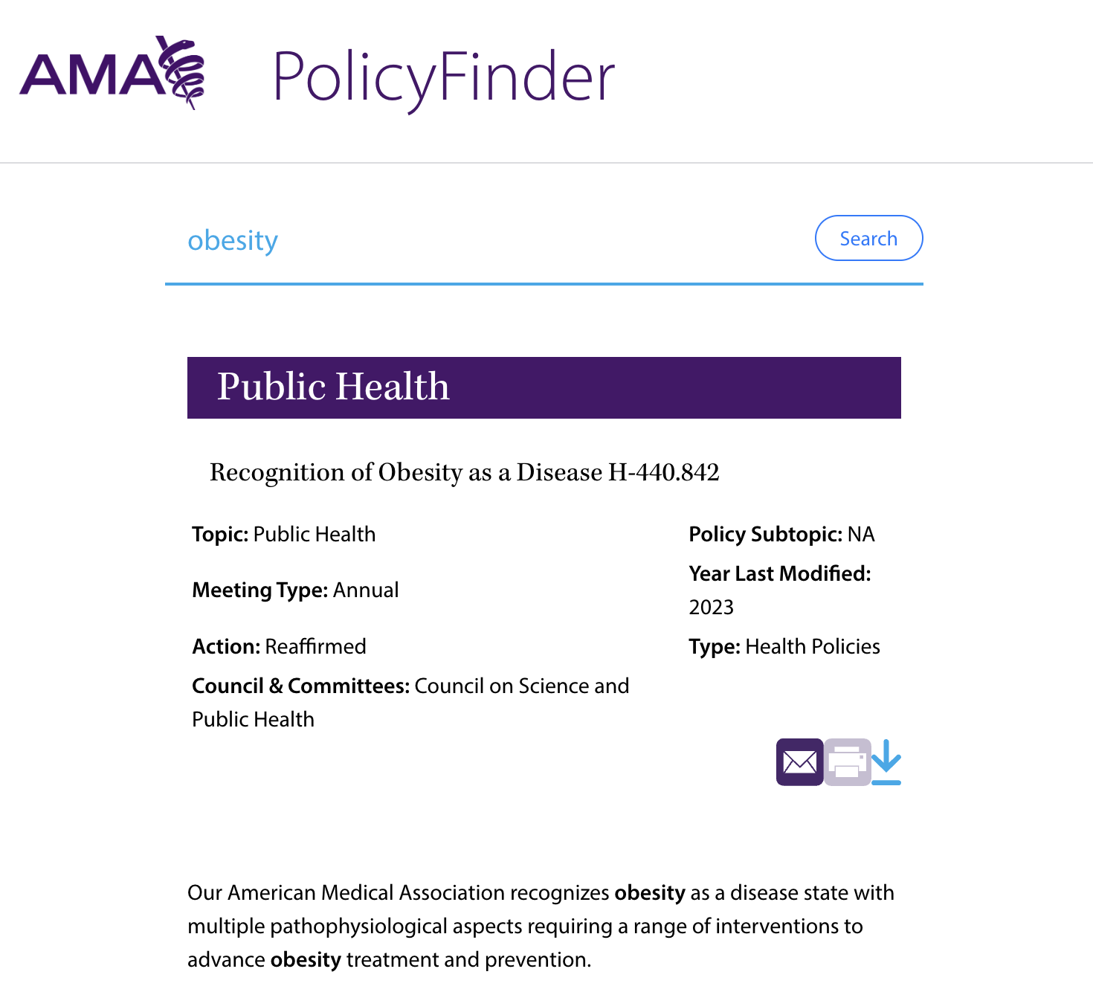

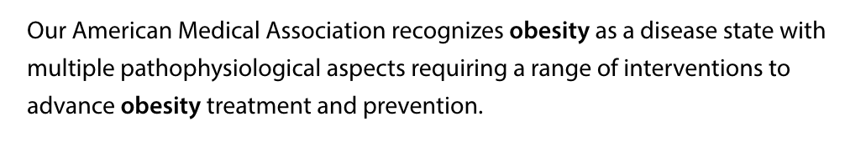

Slide 15
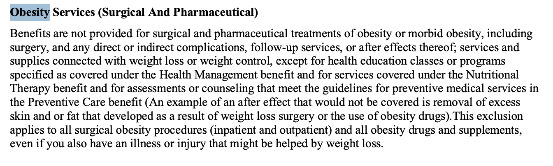

Slide 16
Two Surveys
I surveyed state benchmark plans that implement the Affordable Care Act’s essential health benefits requirement with respect to coverage and/or exclusion of weight loss and blood glucose treatments and services as well as other weight-related services (e.g., bariatric surgery, excess skin removal surgery, weight loss programs).
I also surveyed state mandated benefit laws with respect to coverage and/or exclusion of weight loss and blood glucose medications.

Slide 17
State Benchmark Plan
Search Result Categories
Prescription medications*
Bariatric surgery
Surgeries to remove excess skin and fat following weight loss
Weight loss programs
Nutritional counseling and dietary education*
Mental health treatments and services
*Diabetes-related treatments, services, and supplies

Slide 18
Prescription Medications

Slide 19
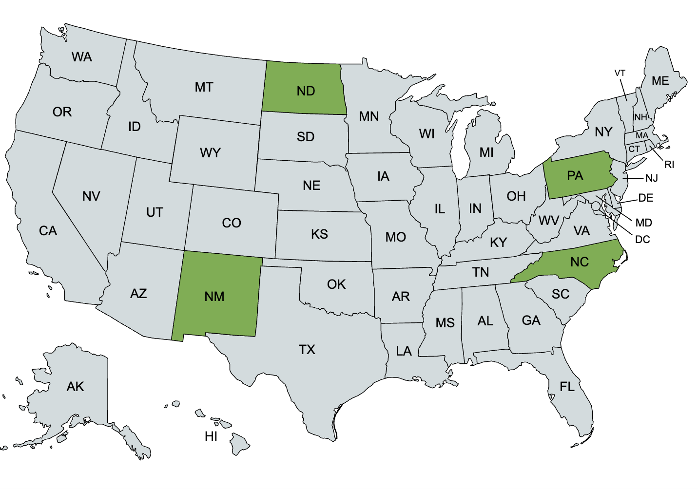
Only four (4) states have benchmark plans that expressly (or potentially impliedly) cover some weight loss and blood glucose medications*

Slide 20


Slide 21

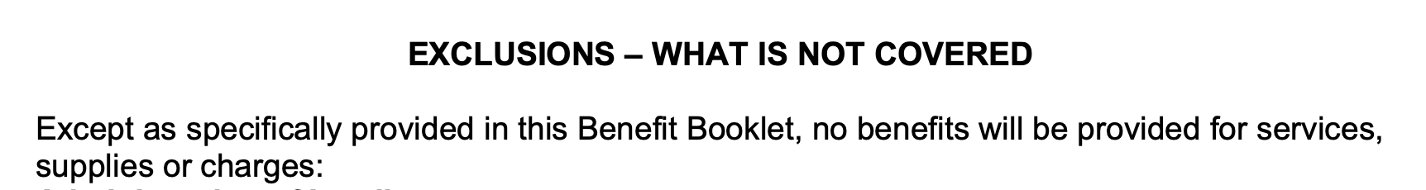

Slide 22
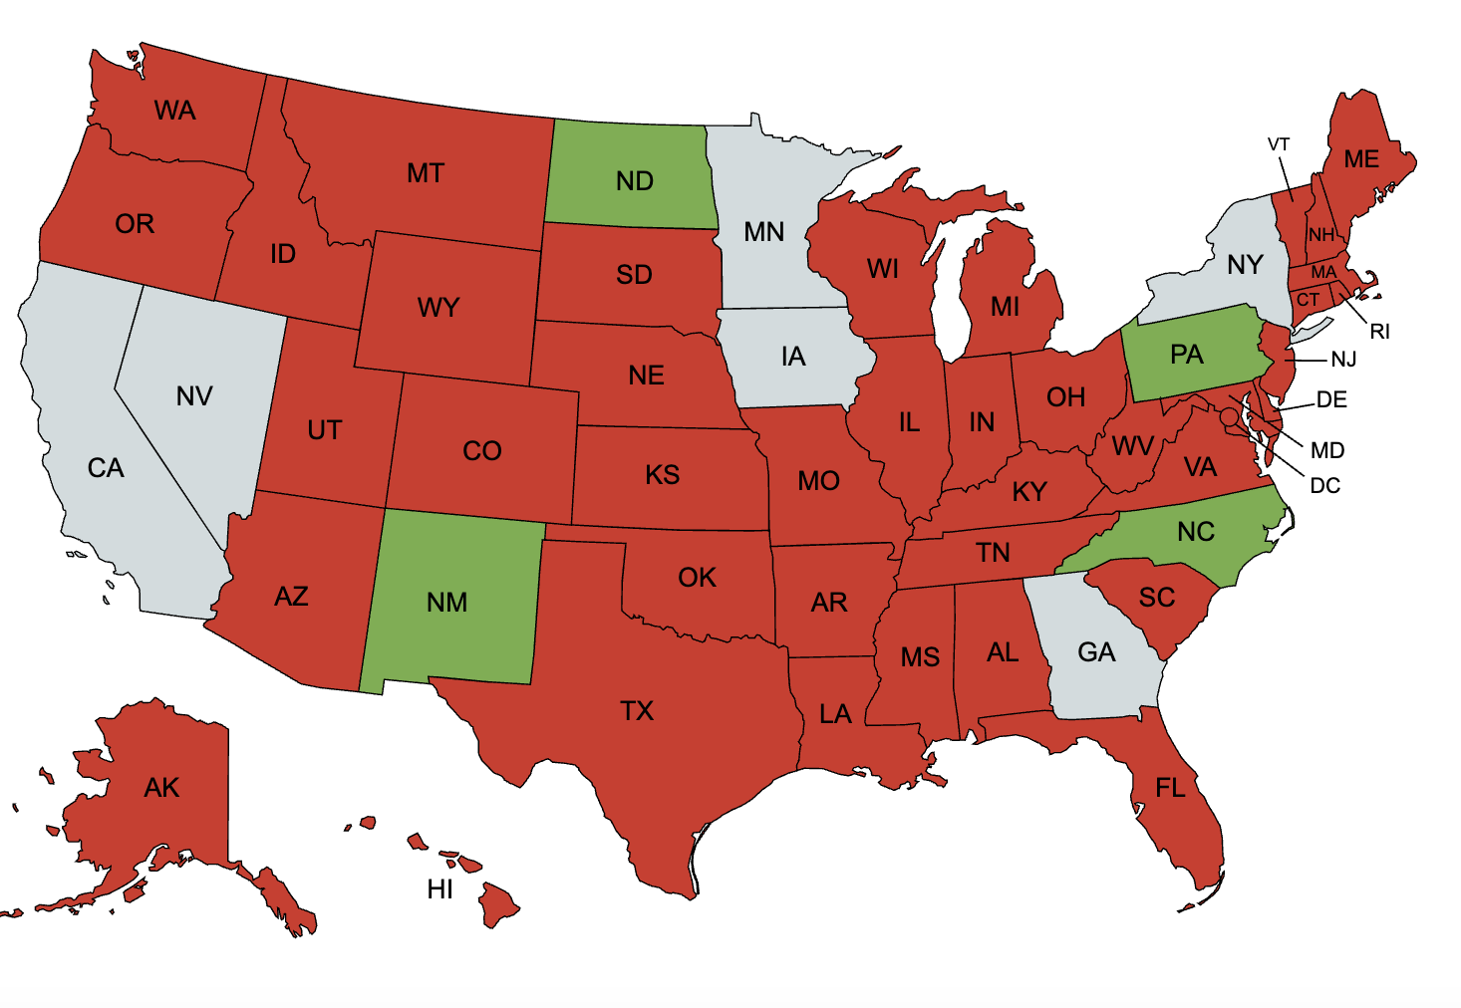
On the other hand, more than 80% of states have benchmark plans that expressly exclude most or all weight loss and blood glucose medications

Slide 23

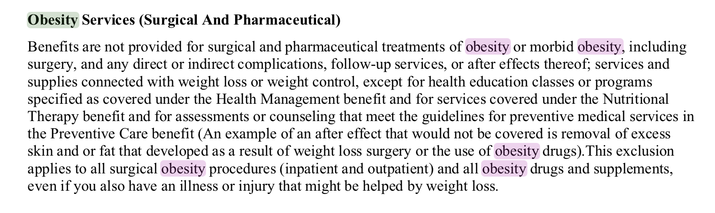

Slide 24


Slide 25
Bariatric Surgery

Slide 26
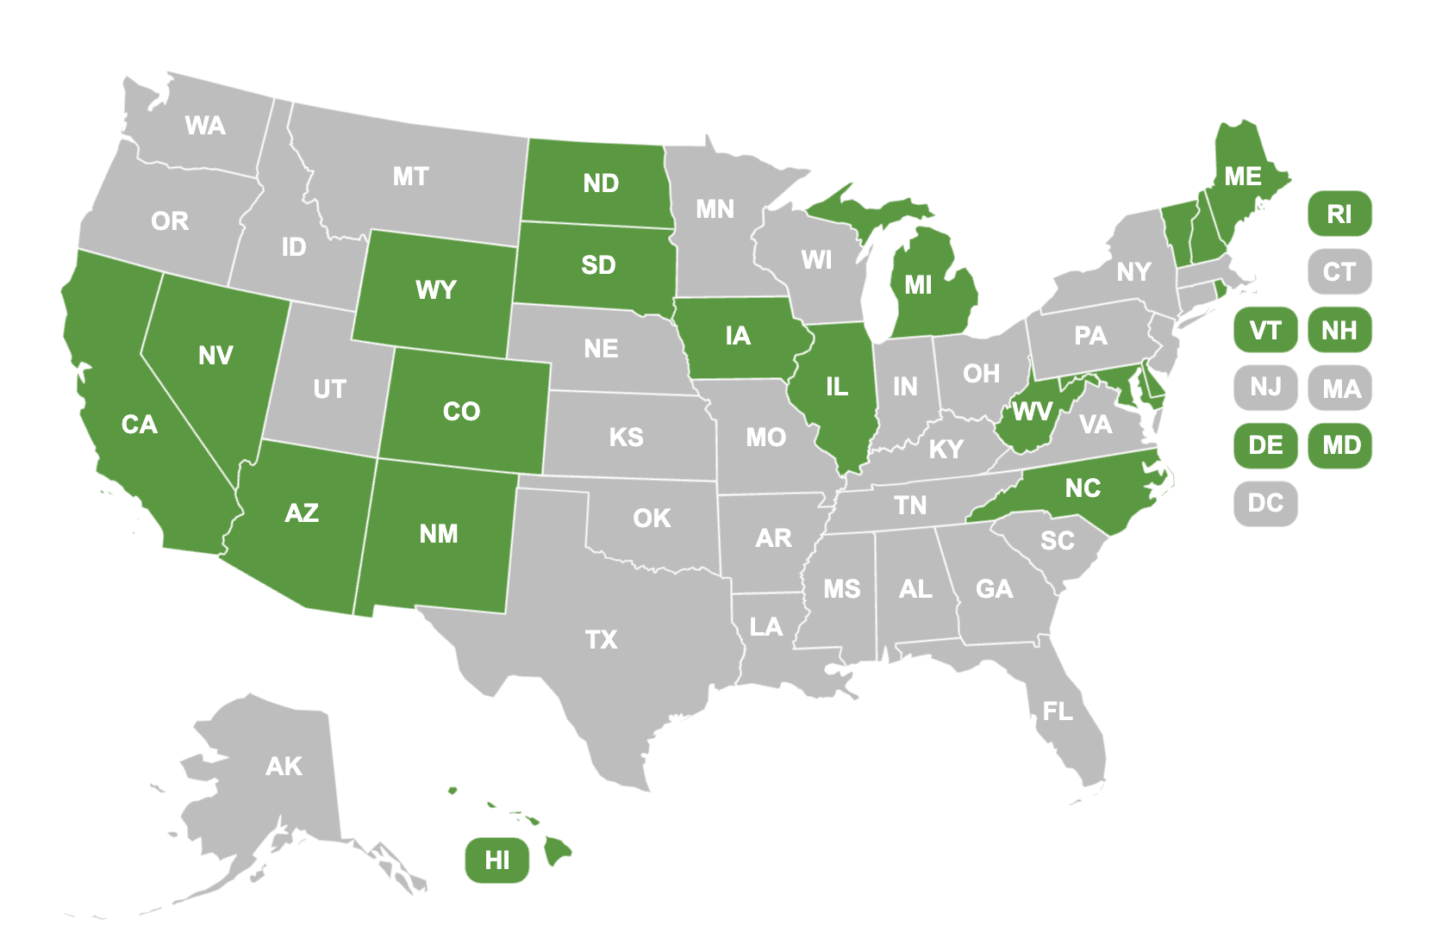
Twenty (20) states have benchmark plans that expressly or impliedly cover at least one type of bariatric surgery if certain coverage criteria are met.

Slide 27
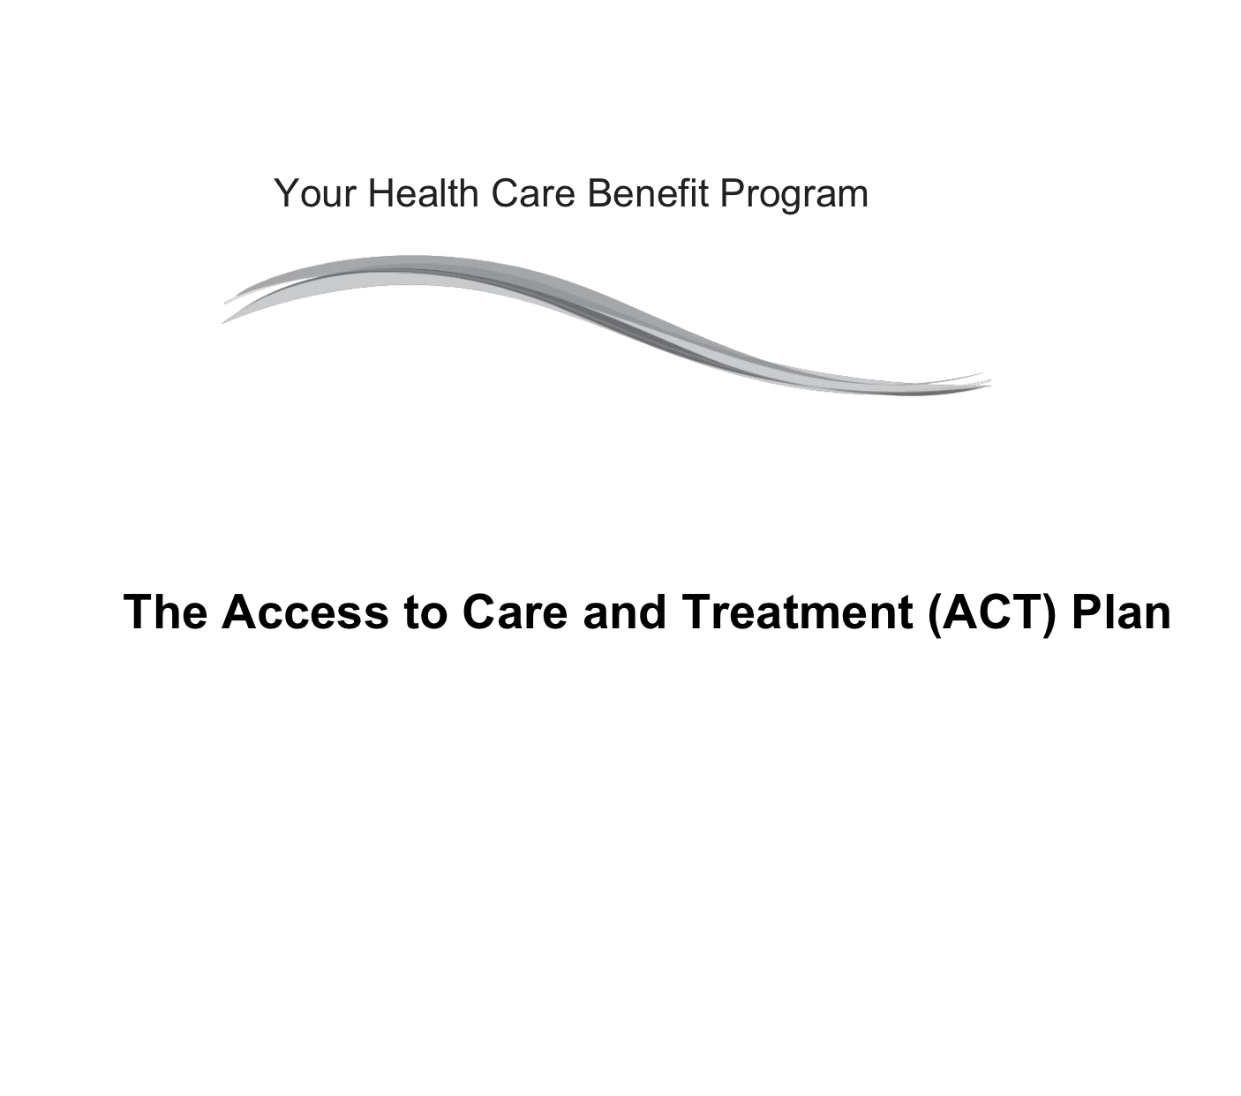
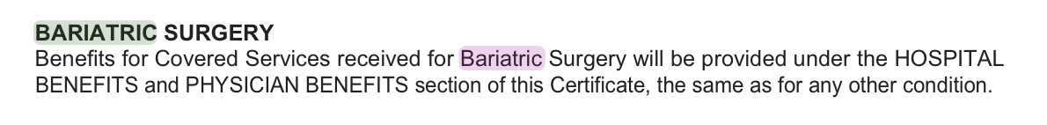
Illinois
Illinois

Slide 28
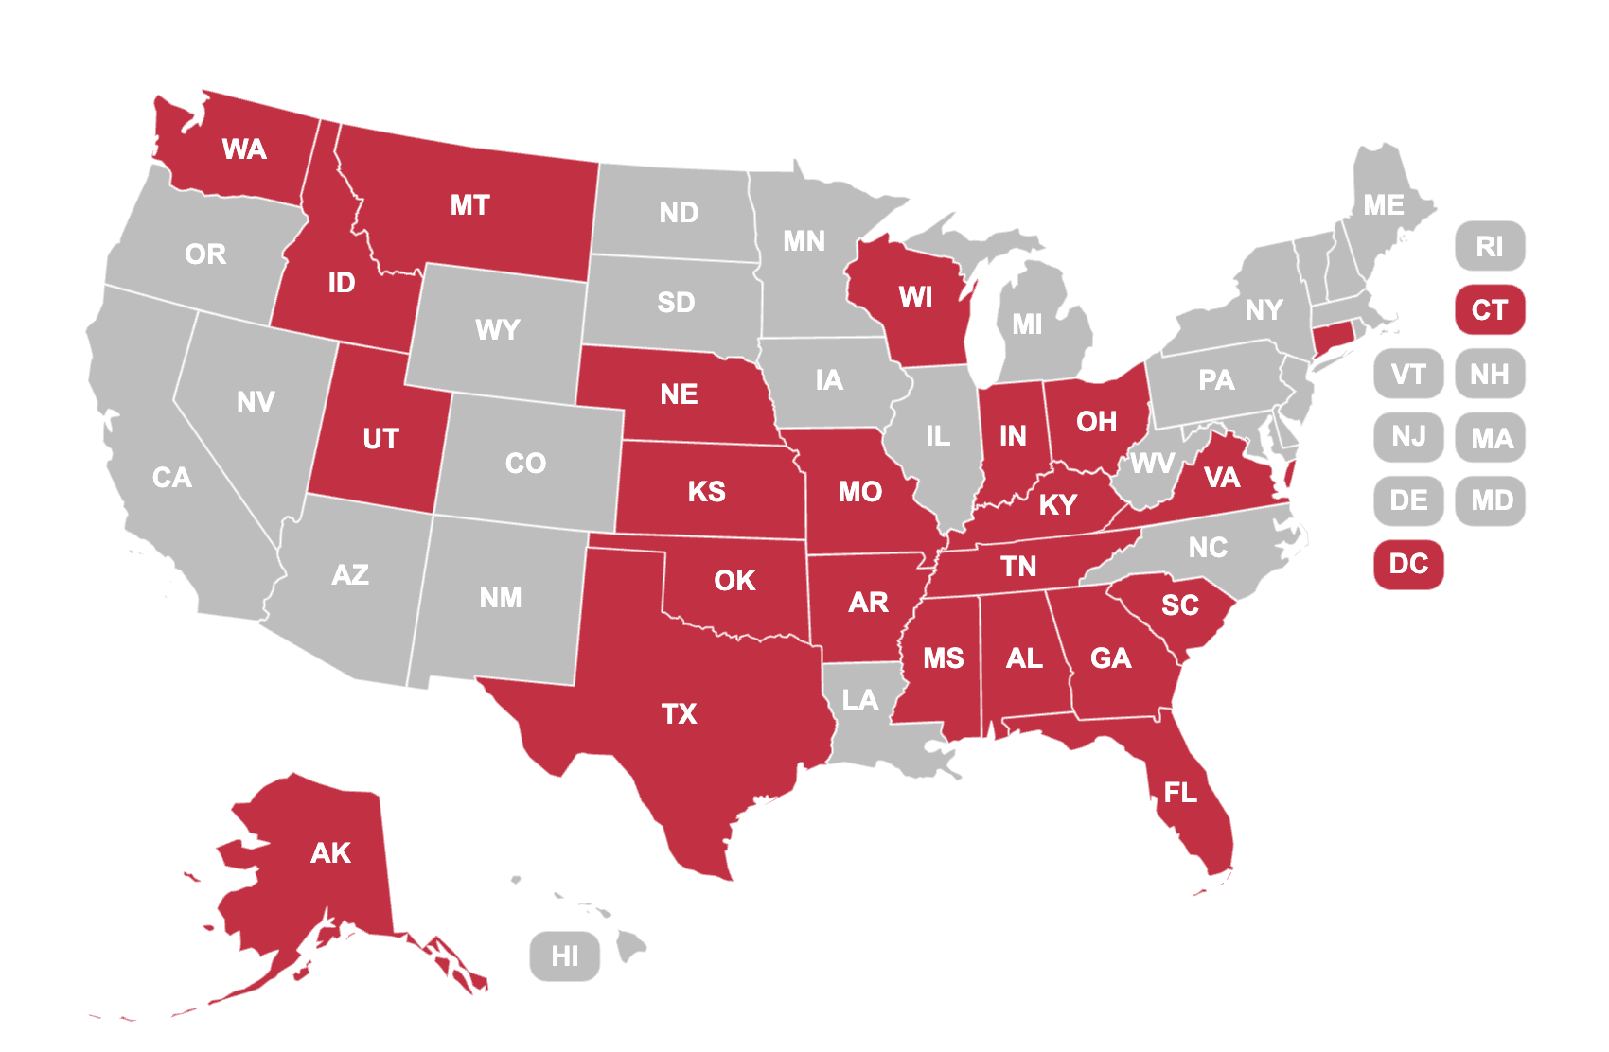
Twenty-four states have benchmark plans that expressly exclude bariatric surgeries as a class

Slide 29
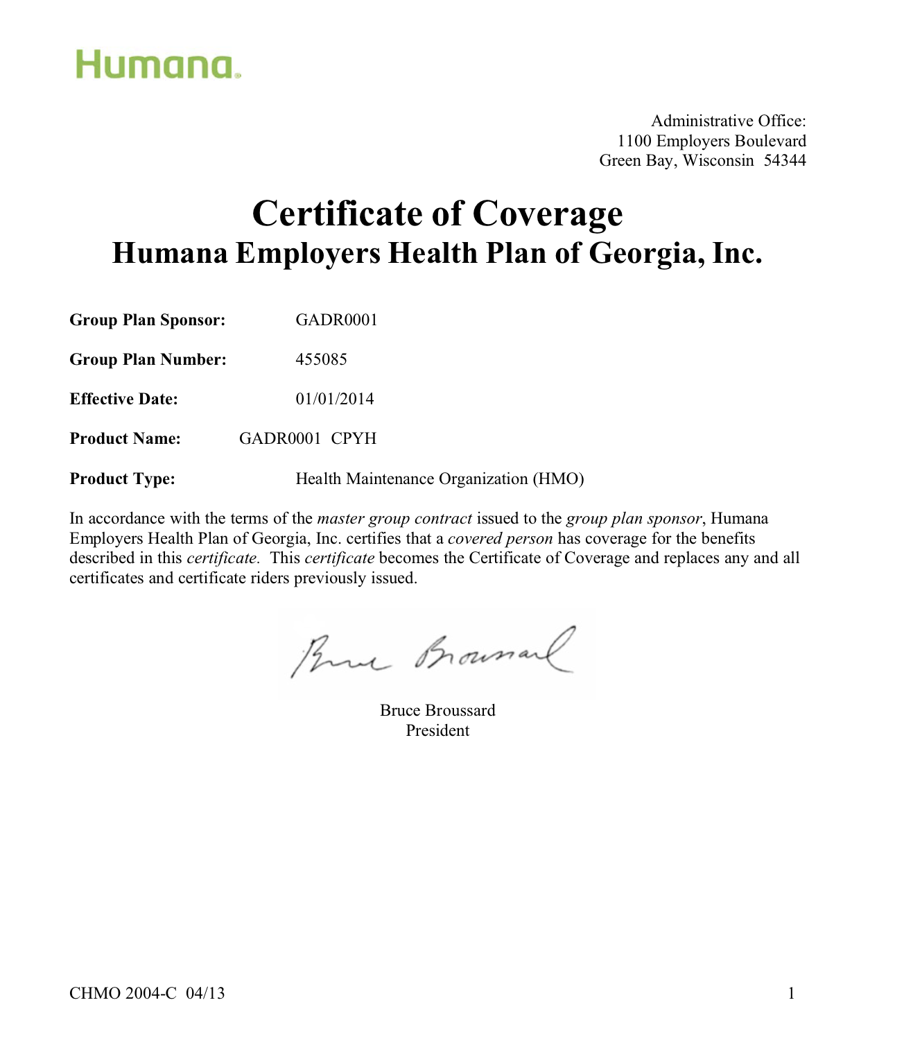
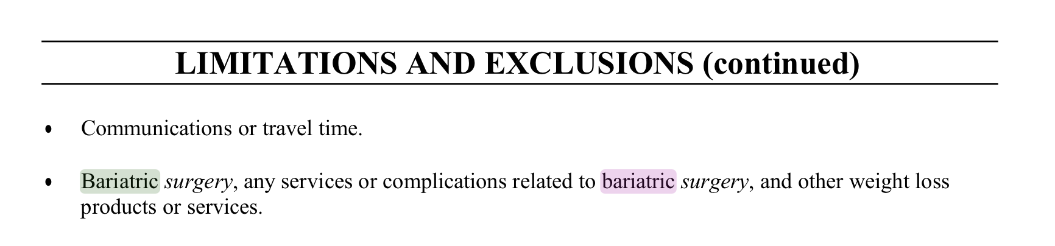

Slide 30
Surgery to Remove Excess Skin and Fat Following Weight Loss

Slide 31
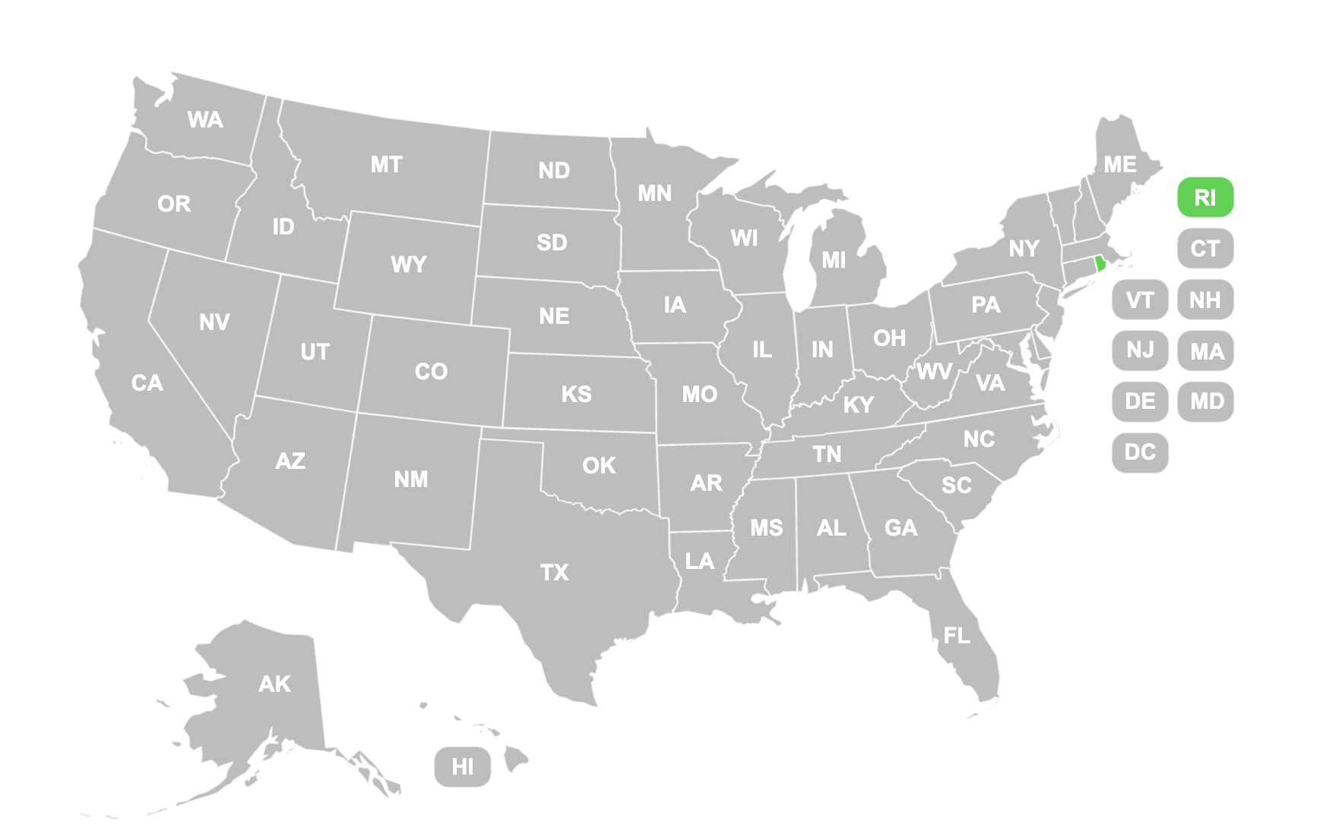
One (1) state is willing to cover medically necessary panniculectomies (although this state clarifies that it does not also cover abdominoplasties)

Slide 32
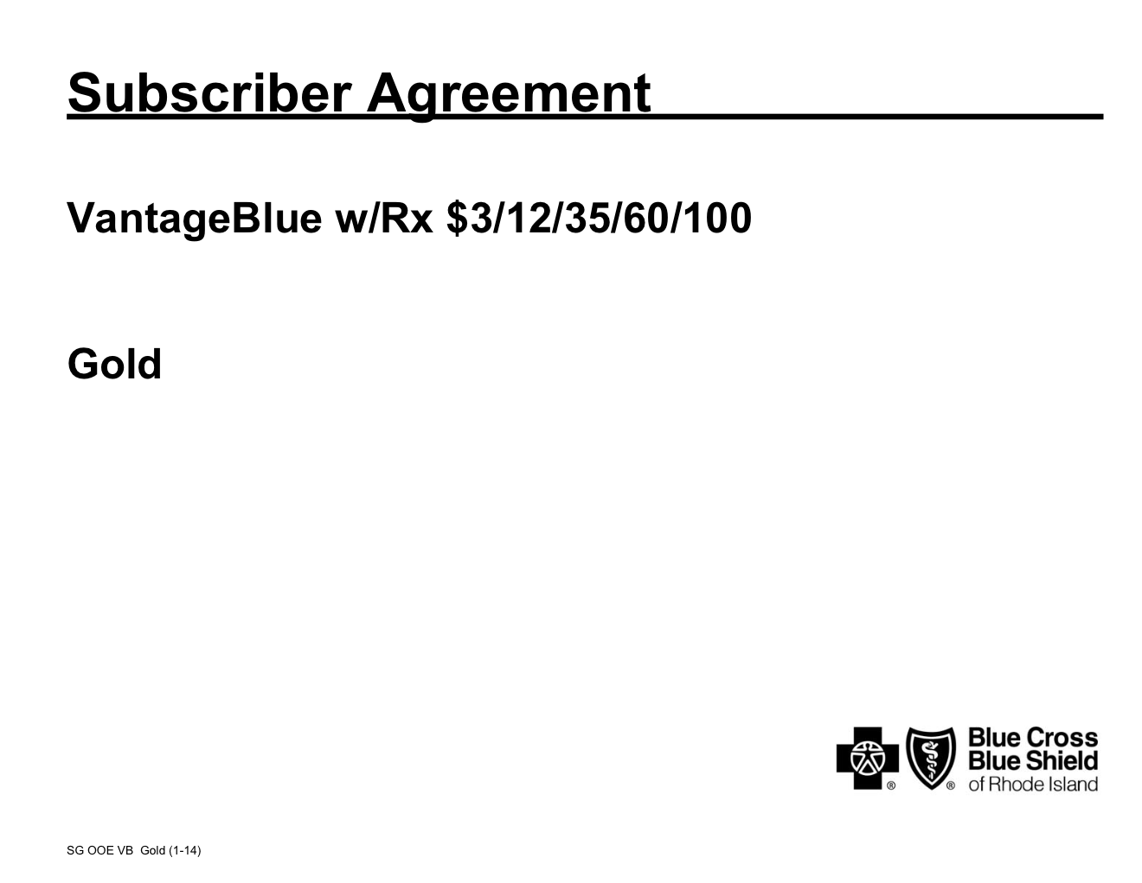

Slide 33
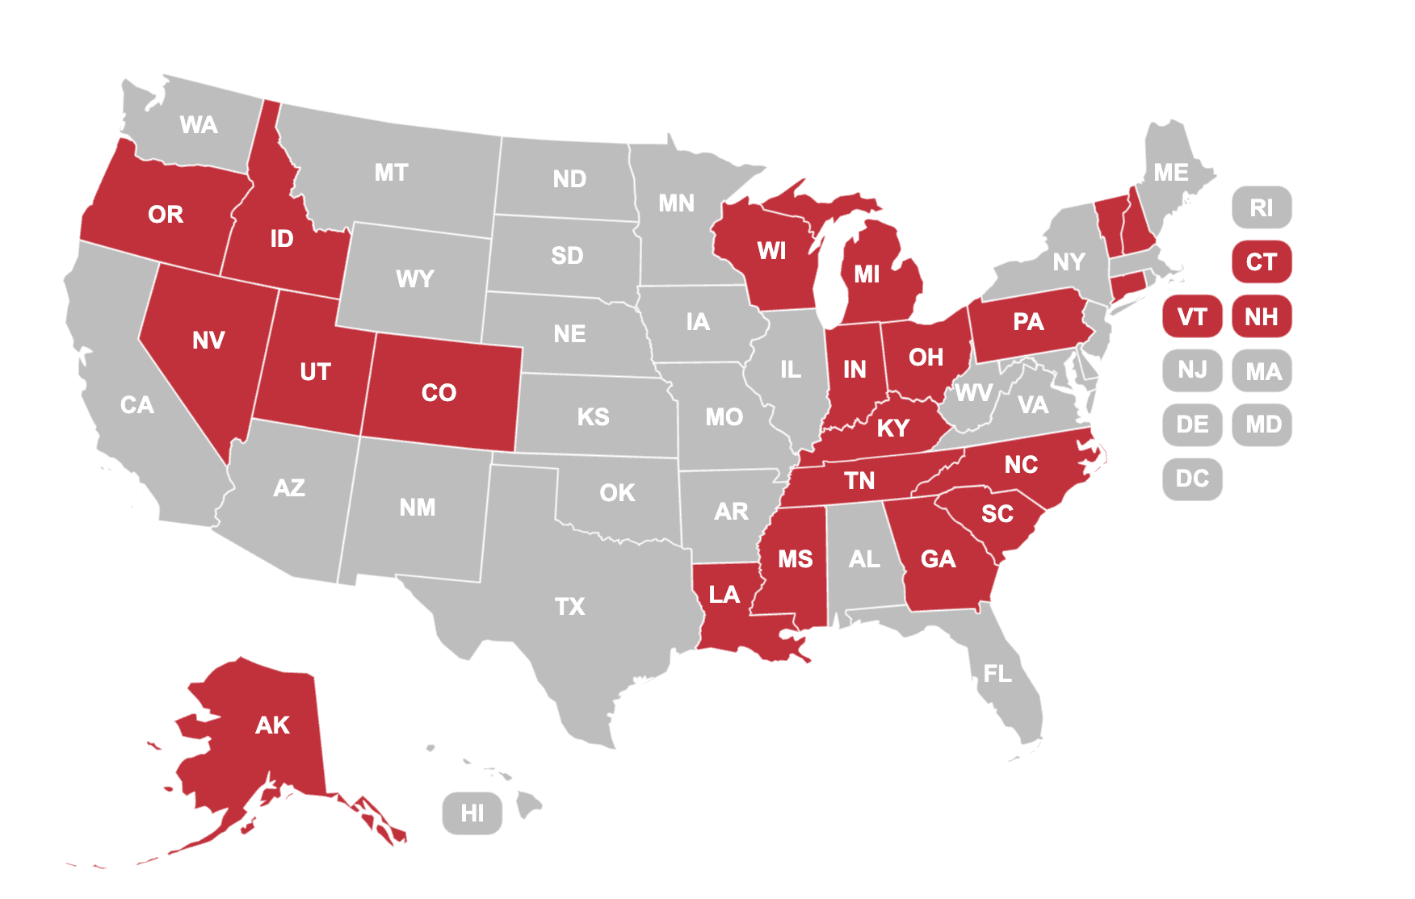
Twenty-one (21) states have benchmark plans that expressly or impliedly exclude the removal of excess skin and fat following weight loss

Slide 34
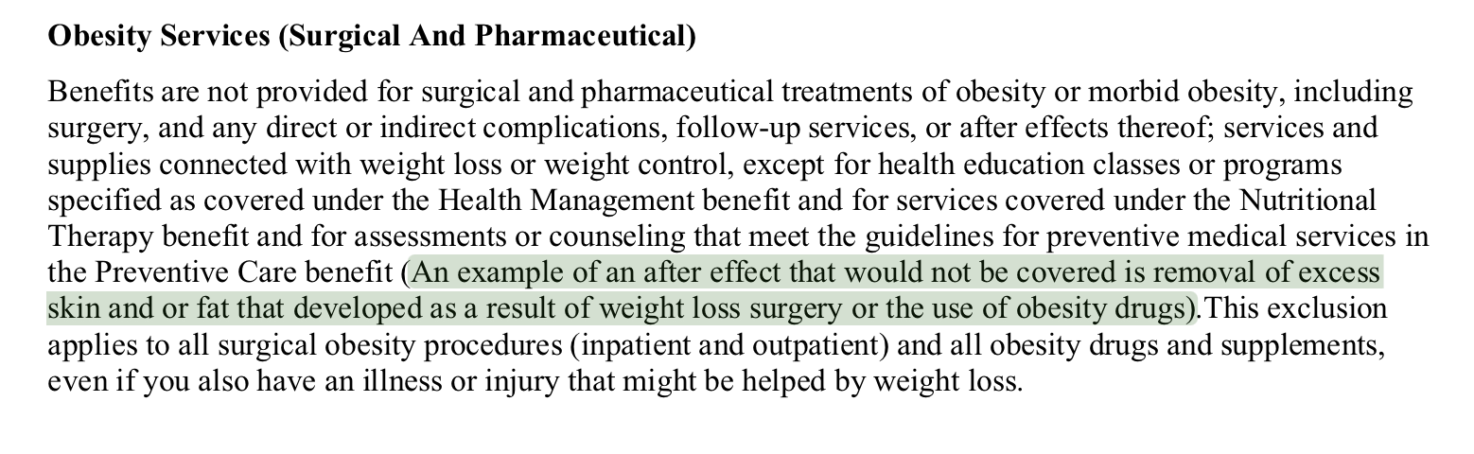

Slide 35
Weight Loss Programs

Slide 36
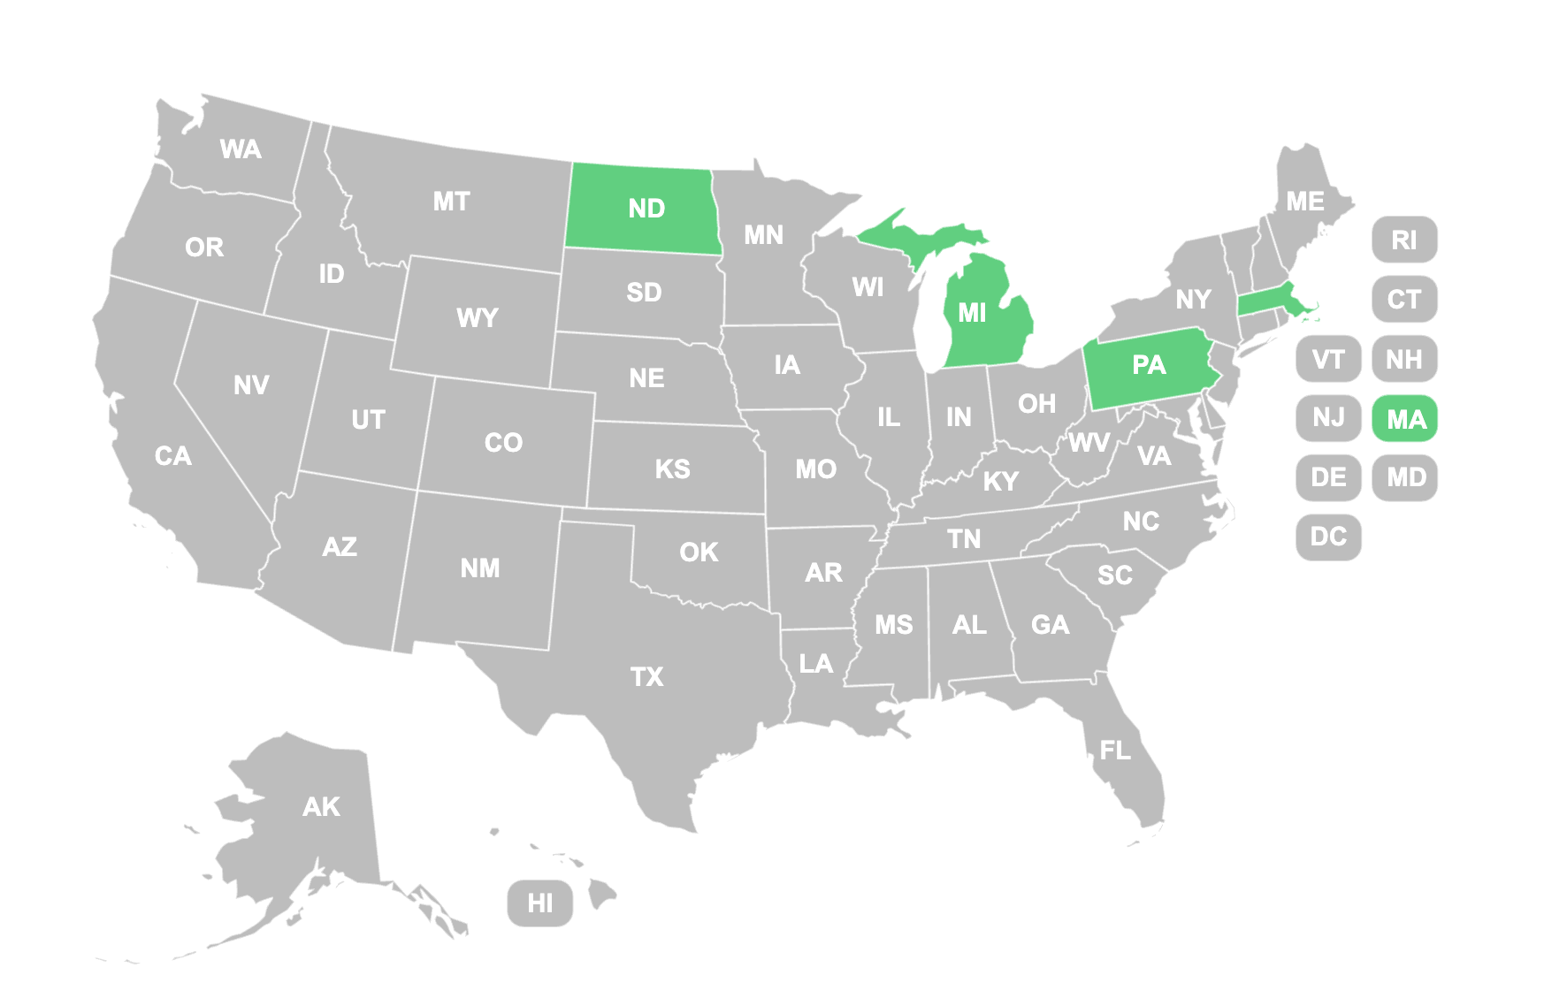
Four (4) states have benchmark plans that expressly or impliedly cover at least some weight loss programs.

Slide 37
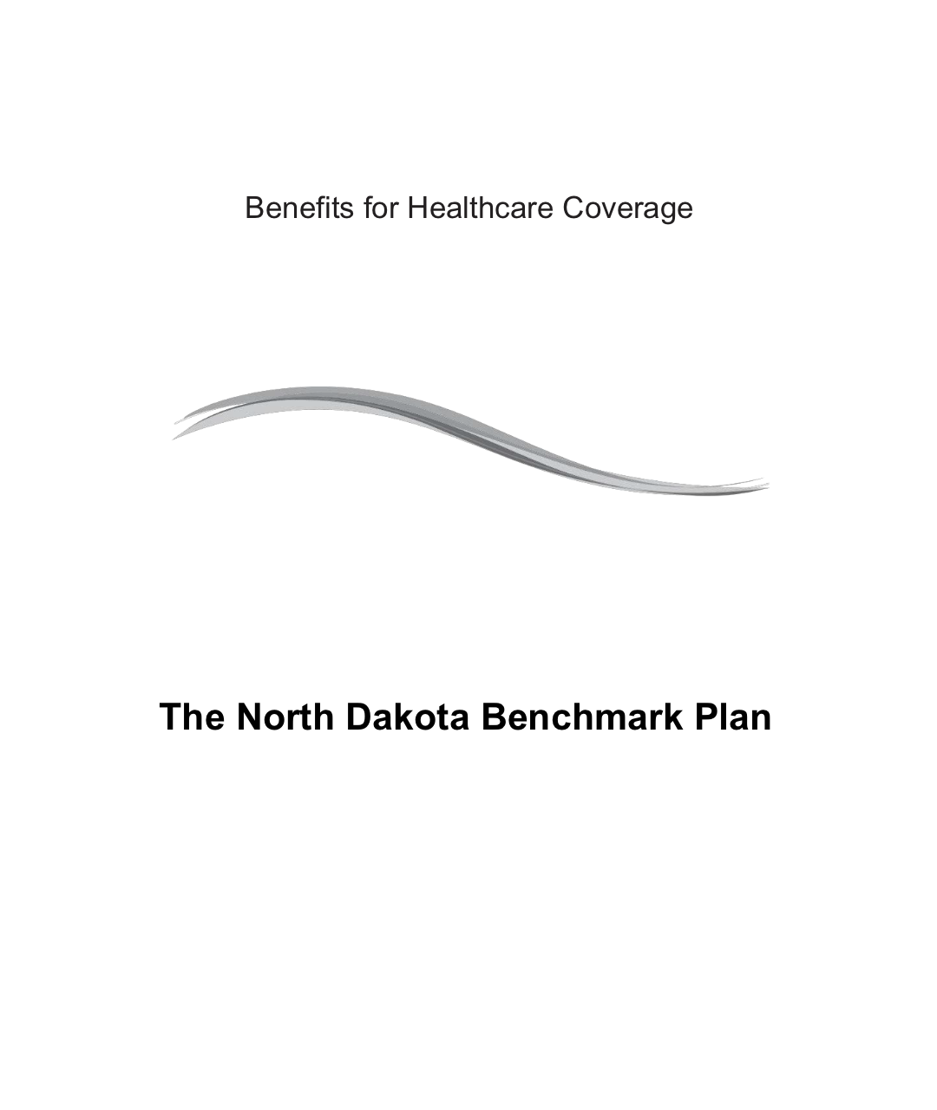
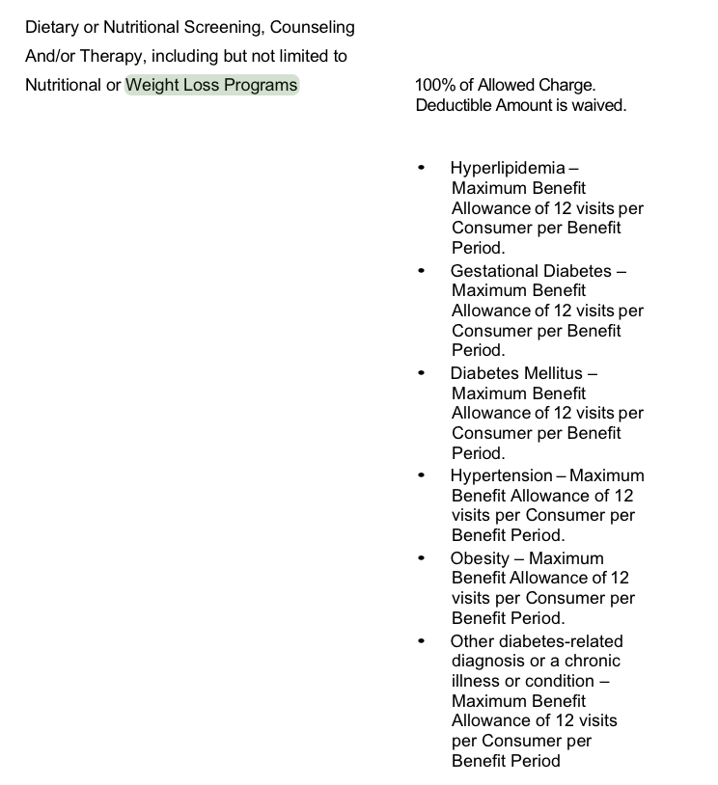

Slide 38
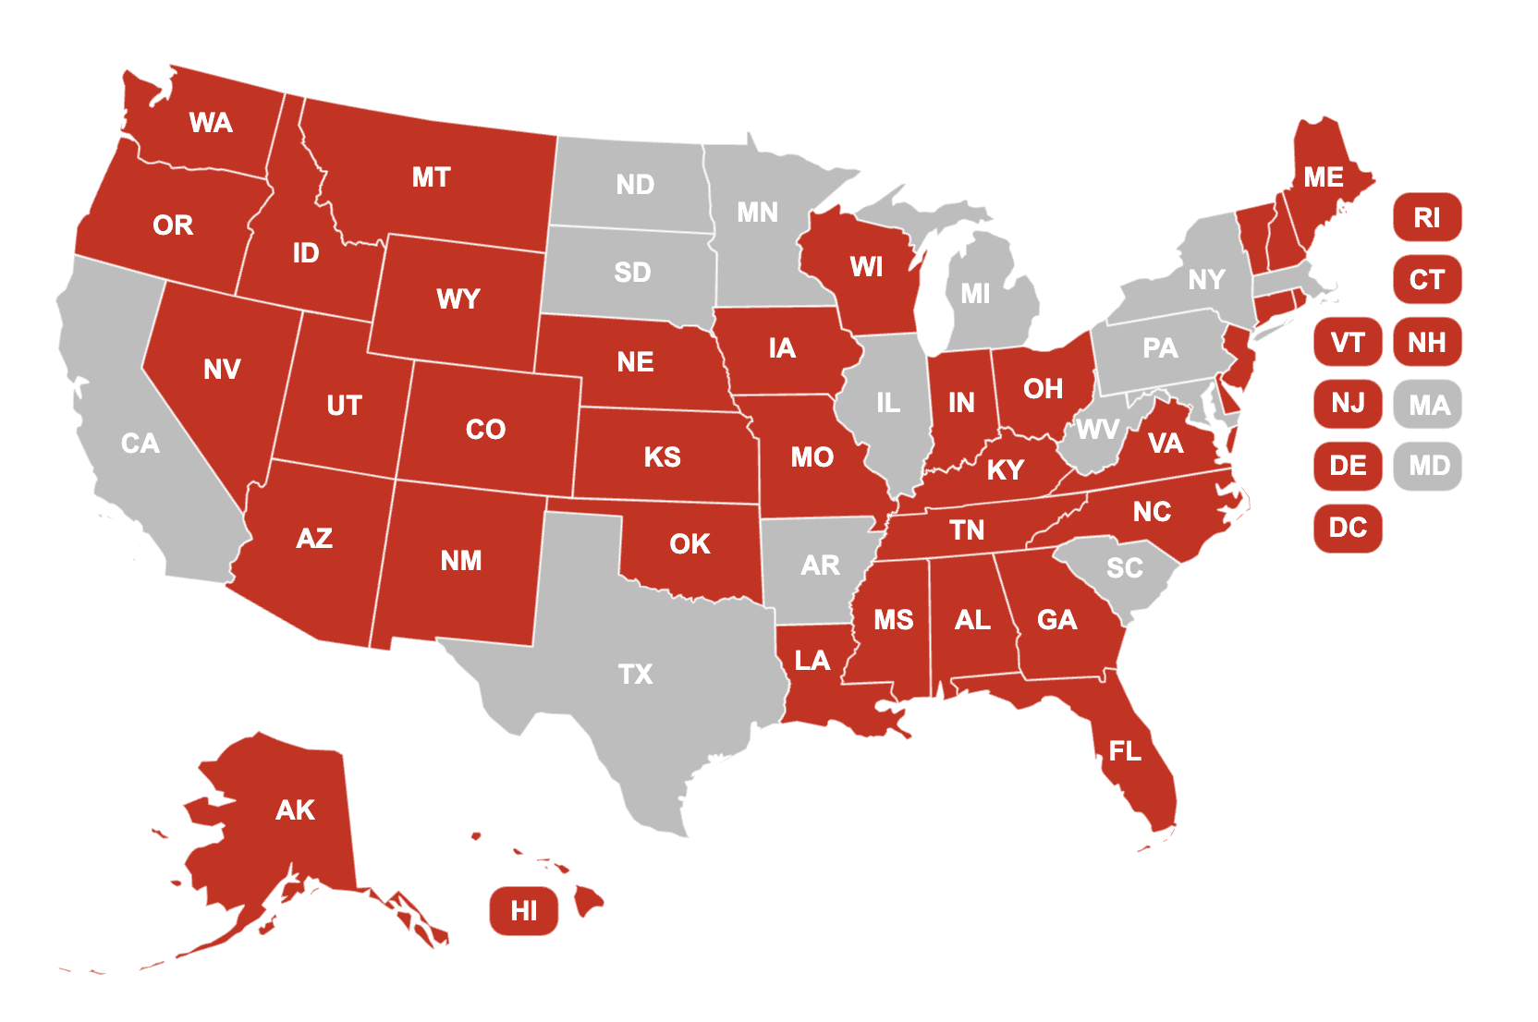
Thirty-seven (37) states have benchmark plans that expressly or impliedly exclude weight loss programs.

Slide 39

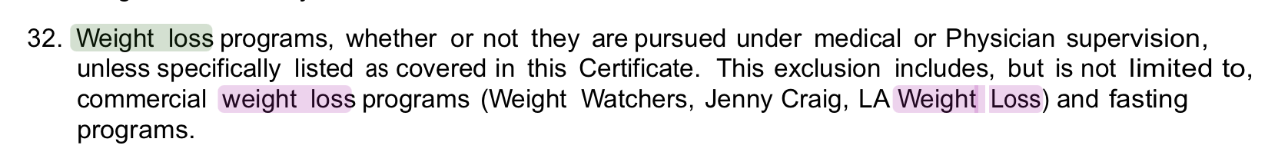
Indiana

Slide 40
State Benchmark Plan
Search Result Categories
Prescription medications*
Bariatric surgery
Surgeries to remove excess skin and fat following weight loss
Weight loss programs
Nutritional counseling and dietary education*
Mental health treatments and services
*Diabetes-related treatments, services, and supplies

Slide 41
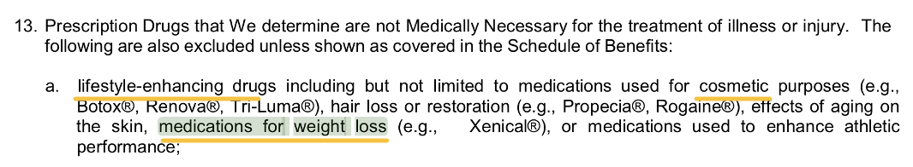

Slide 42
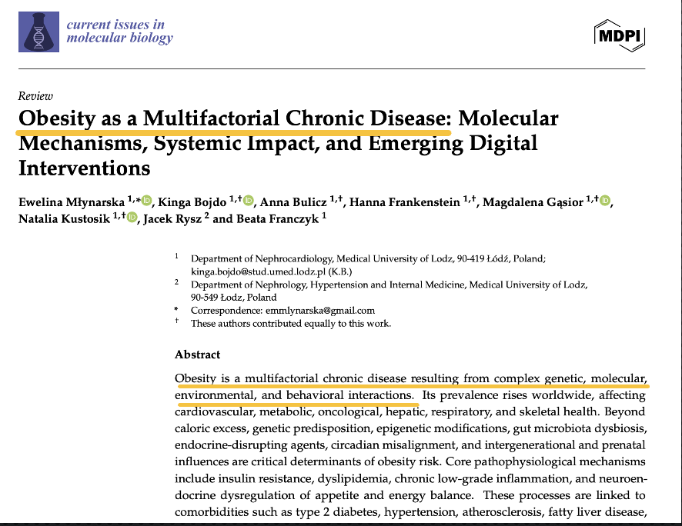
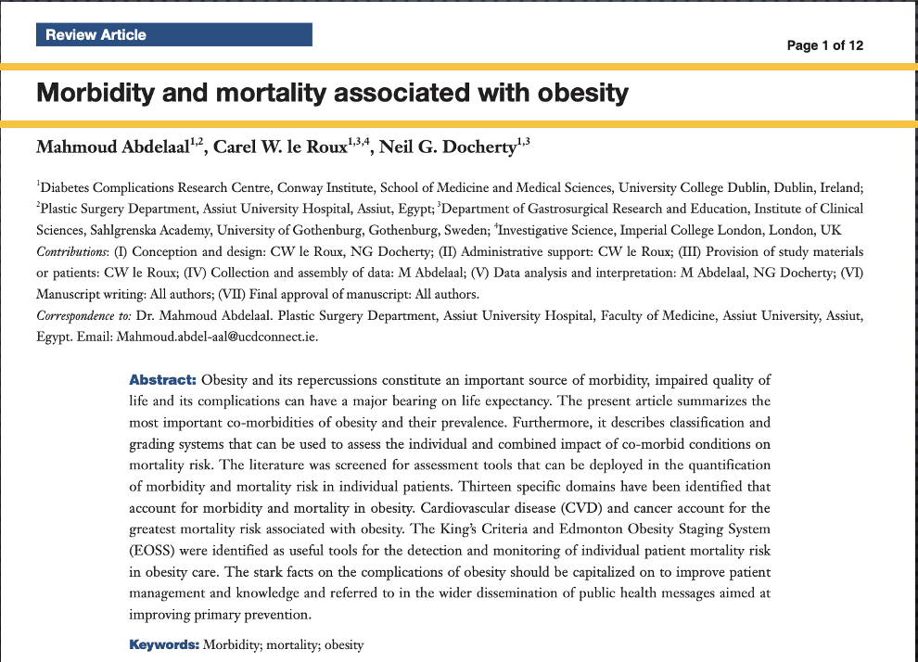
1. For many individuals, obesity is not a cosmetic or lifestyle issue. It is a complex, chronic, multi-factorial health condition that carries significant risk of poor health and early death.

Slide 43
History: State Benchmark Plan Selection
  1st Benchmark Plan Selection: Plan sold in 2012 (effective for the 2014-2016 plan years).
  2nd Benchmark Plan Re-Selection: Plan sold in 2014 (effective for the 2017-2019 plan years).
  3rd Benchmark Plan Re-Selection: All states except Illinois kept their prior benchmark plan (effective for the 2020 plan year).
  4th Benchmark Plan Re-Selection: All states except South Dakota kept their prior benchmark plan (effective for the 2021 plan year).
  5th Benchmark Plan Re-Selection: All states except Michigan, New Mexico, and Oregon kept their prior benchmark plan (effective for the 2022 plan year).

Slide 44
History: State Benchmark Plan Selection
  6th Benchmark Plan Re-Selection: All states except Colorado kept their prior benchmark plan (effective for the 2023 plan year).
  7th Benchmark Plan Re-Selection: All states except Vermont kept their prior benchmark plan (effective for the 2024 plan year).
  8th Benchmark Plan Re-Selection: All states except North Dakota and Virginia kept their prior benchmark plan (effective for the 2025 plan year).
  9th Benchmark Plan Re-Selection: All states except Alaska, District of Columbia, and Washington kept their prior benchmark plan (effective for the 2026 plan year).
  10th Benchmark Plan Re-Selection: All states except Colorado kept their prior benchmark plan (effective for the 2027 plan year).

Slide 45


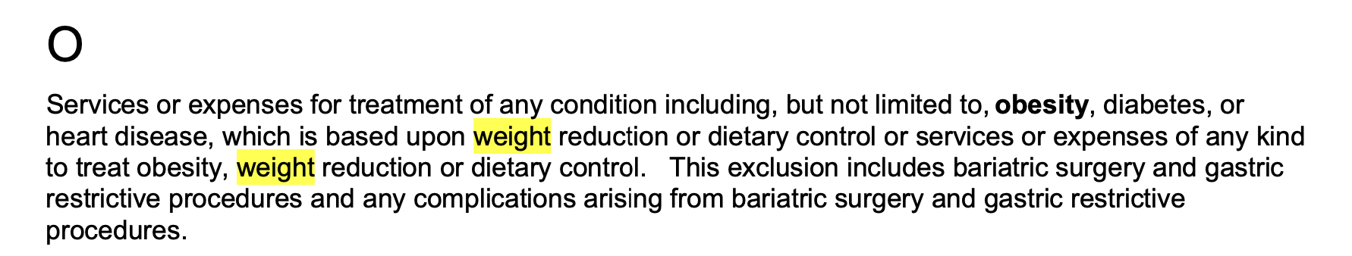

Slide 46
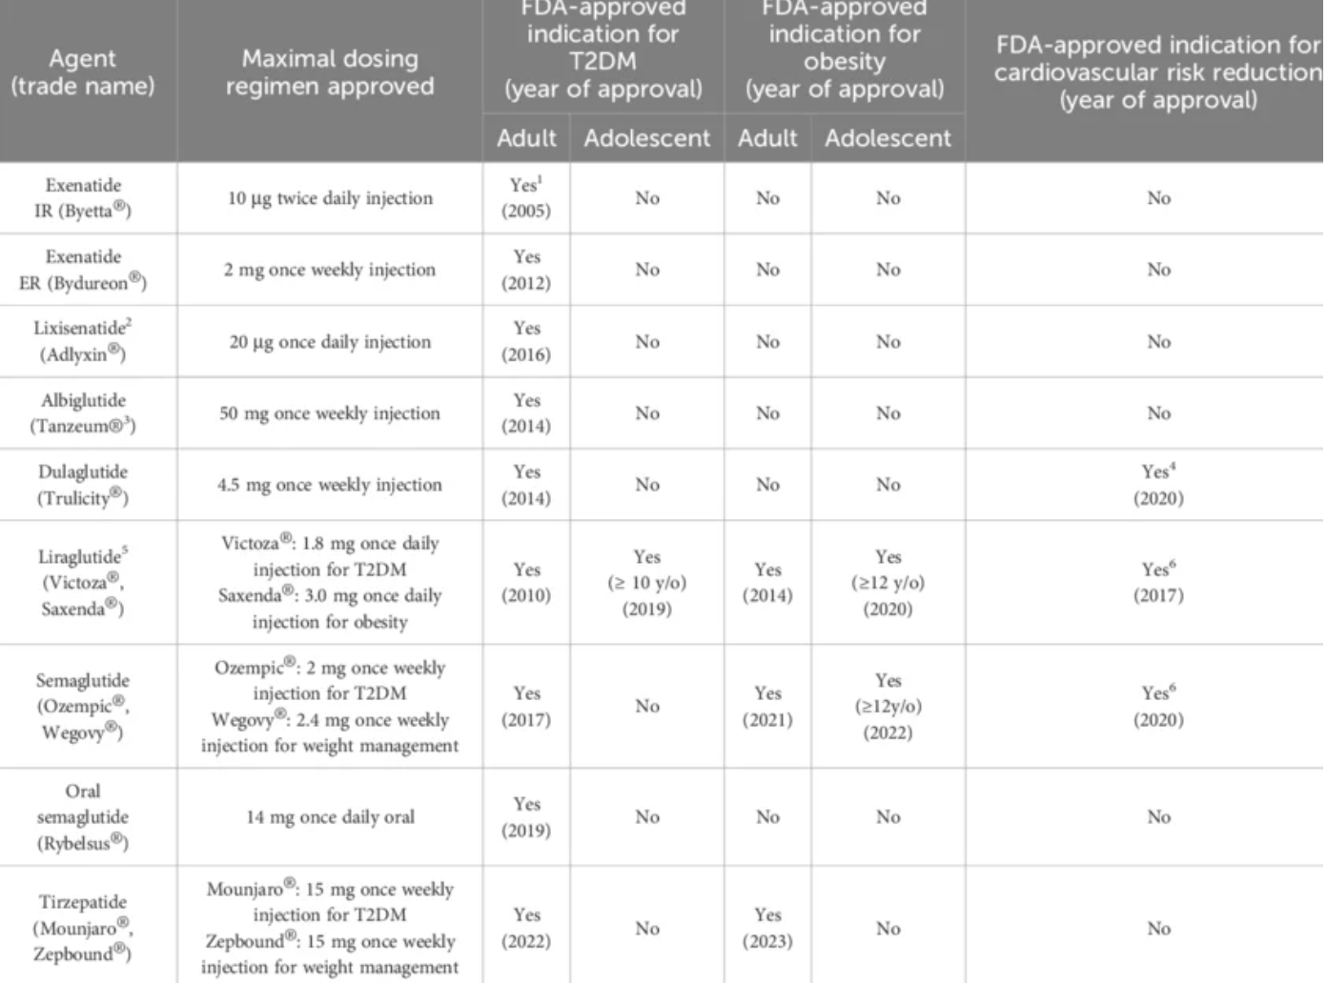

Slide 47
Permissive (not Mandatory)
Benchmark Plan Re-Selection
45 C.F.R. § 156.111(a)(2)
“ . . . a State may change its EHB-benchmark plan by selecting a set of benefits that would become the State's EHB-benchmark plan.”

Slide 48
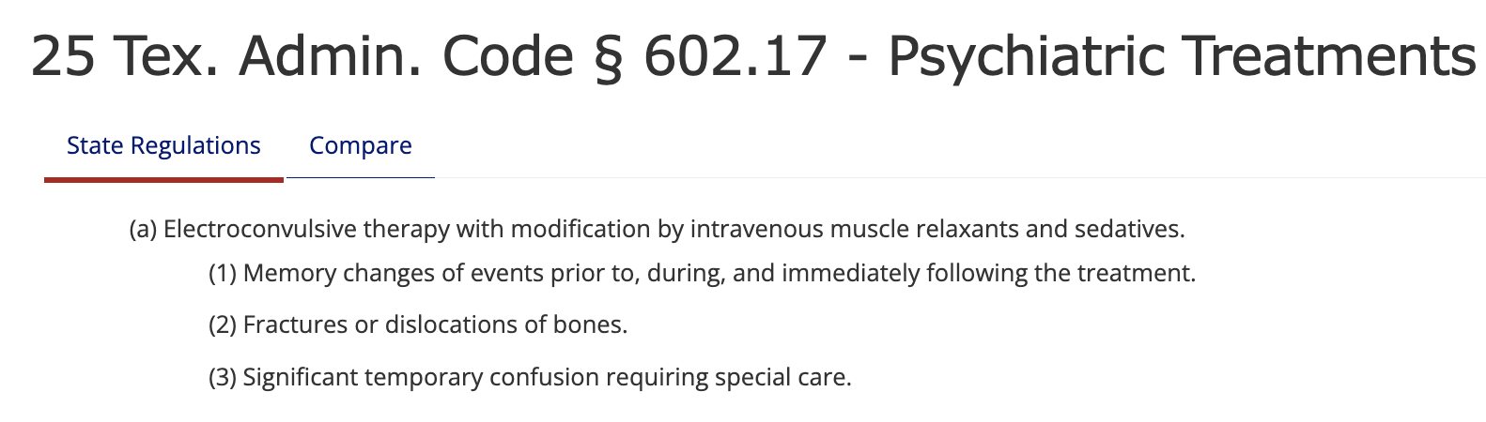

Slide 49
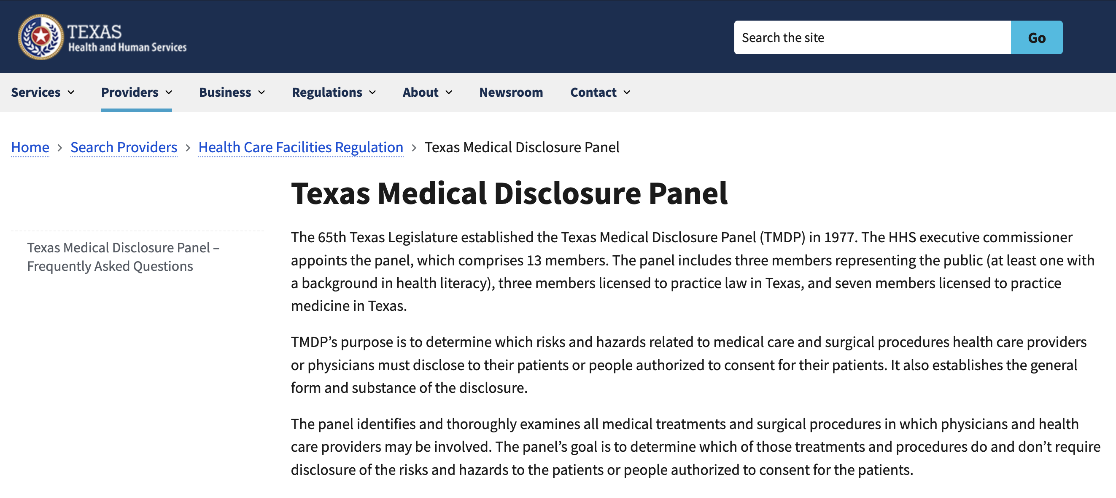
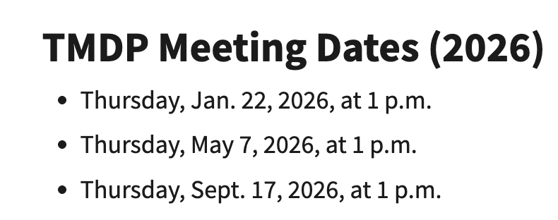

Slide 50
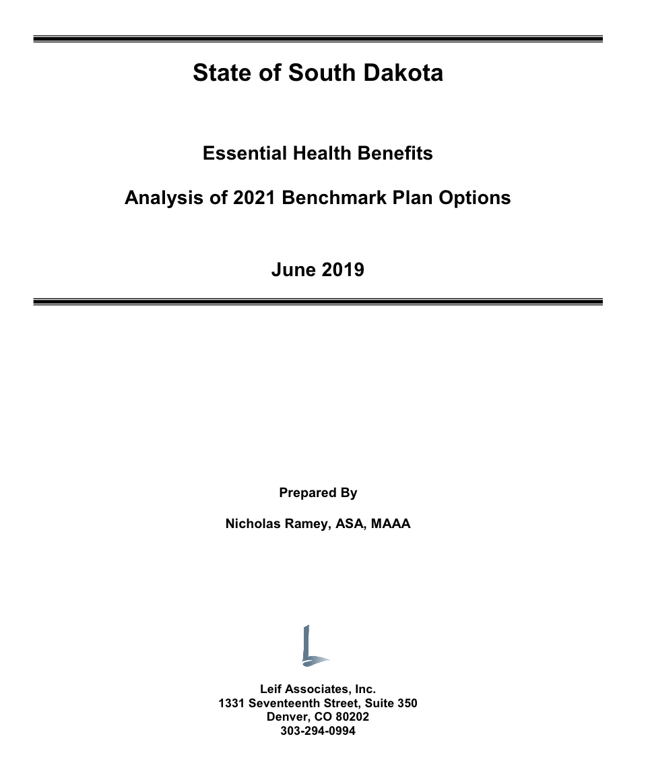
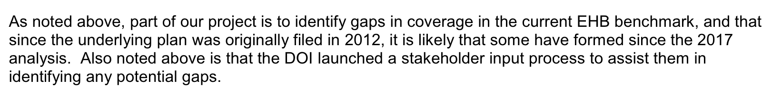

Slide 51
Stacey A. Tovino, Oh-Oh-Oh-Ozempic!
91 Mo. L. Rev. __(forthcoming 2026).
Stacey.Tovino@ou.edu
832/289-6313

Slide 52


Slide 53

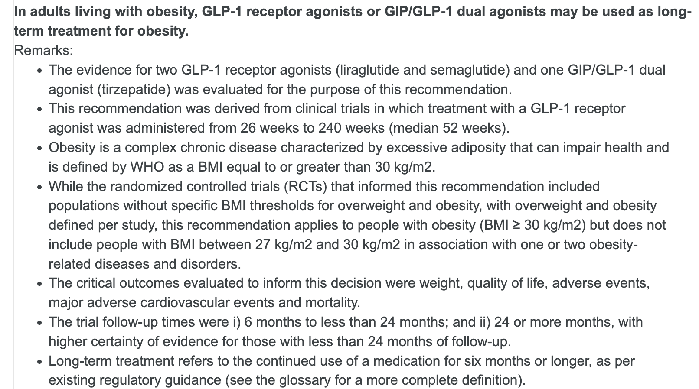

Slide 54
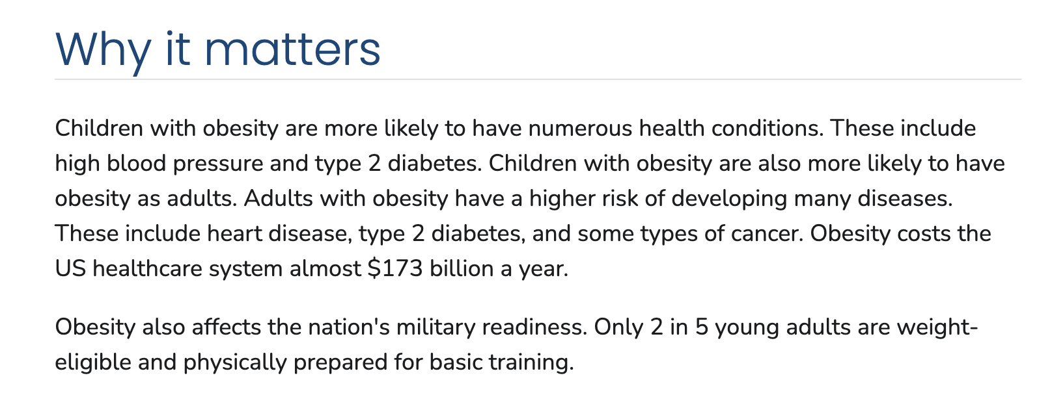

Slide 55
Recommendations
First, federal regulations governing the benchmark plan selection process should require states to consider incorporating advances in disease understanding and evolving standards of care into their benchmark plans.
Treatment advocates, public health officials, and other stakeholders should encourage states to add comprehensive weight loss and blood glucose treatments to their benchmark plans.
States without mandated weight loss and blood glucose benefit laws should enact them.
States with relevant laws should strengthen them.
Employees who belong to self-insured plans should provide feedback to their employers on their plans’ scope of benefits, advocating for comprehensive coverage of weight loss and blood glucose services.
Medicare should adopt a mandated weight loss and blood glucose benefit, which should encourage private insurers to follow suit.

