Slide 1

UAGA update:
Considerations for potential amendments
Section of Medical Ethics
June 2026
Brendan Parent, JD
Associate Professor and Director,
Section of Medical Ethics
NYU Grossman School of Medicine

Slide 2
Disclosures
Applebaum grant studying ethics of xenotransplant
NFRF (Gov’t Canada) grant, study of organ improvement/ organ bioengineering
Grant support from United Therapeutics to study alternatives to animal research
Ethics advisory board member for Procure OnDemand
Ethics advisory board member for Bexorg
NIH NHLBI grant, study of authorization for uncontrolled lung recovery
NIH NHLBI grant, studying donor family and public perceptions of NRP
These are my views and my views alone

Slide 3
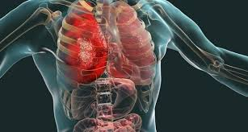
Organs Fail

Slide 4
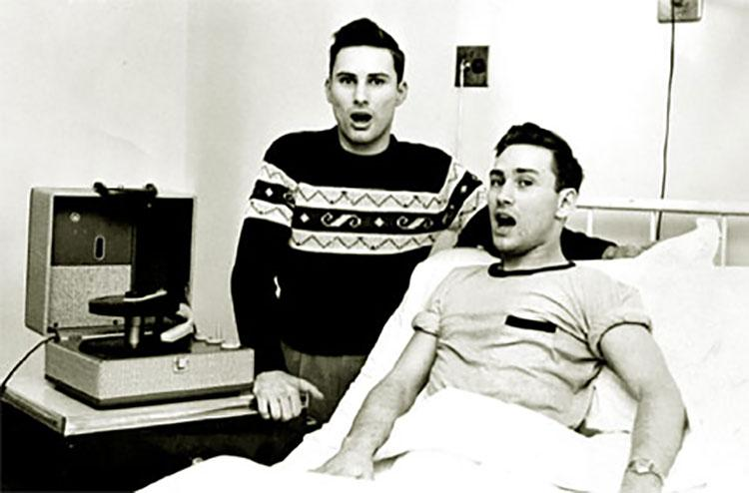
Herrick Twins

Slide 5
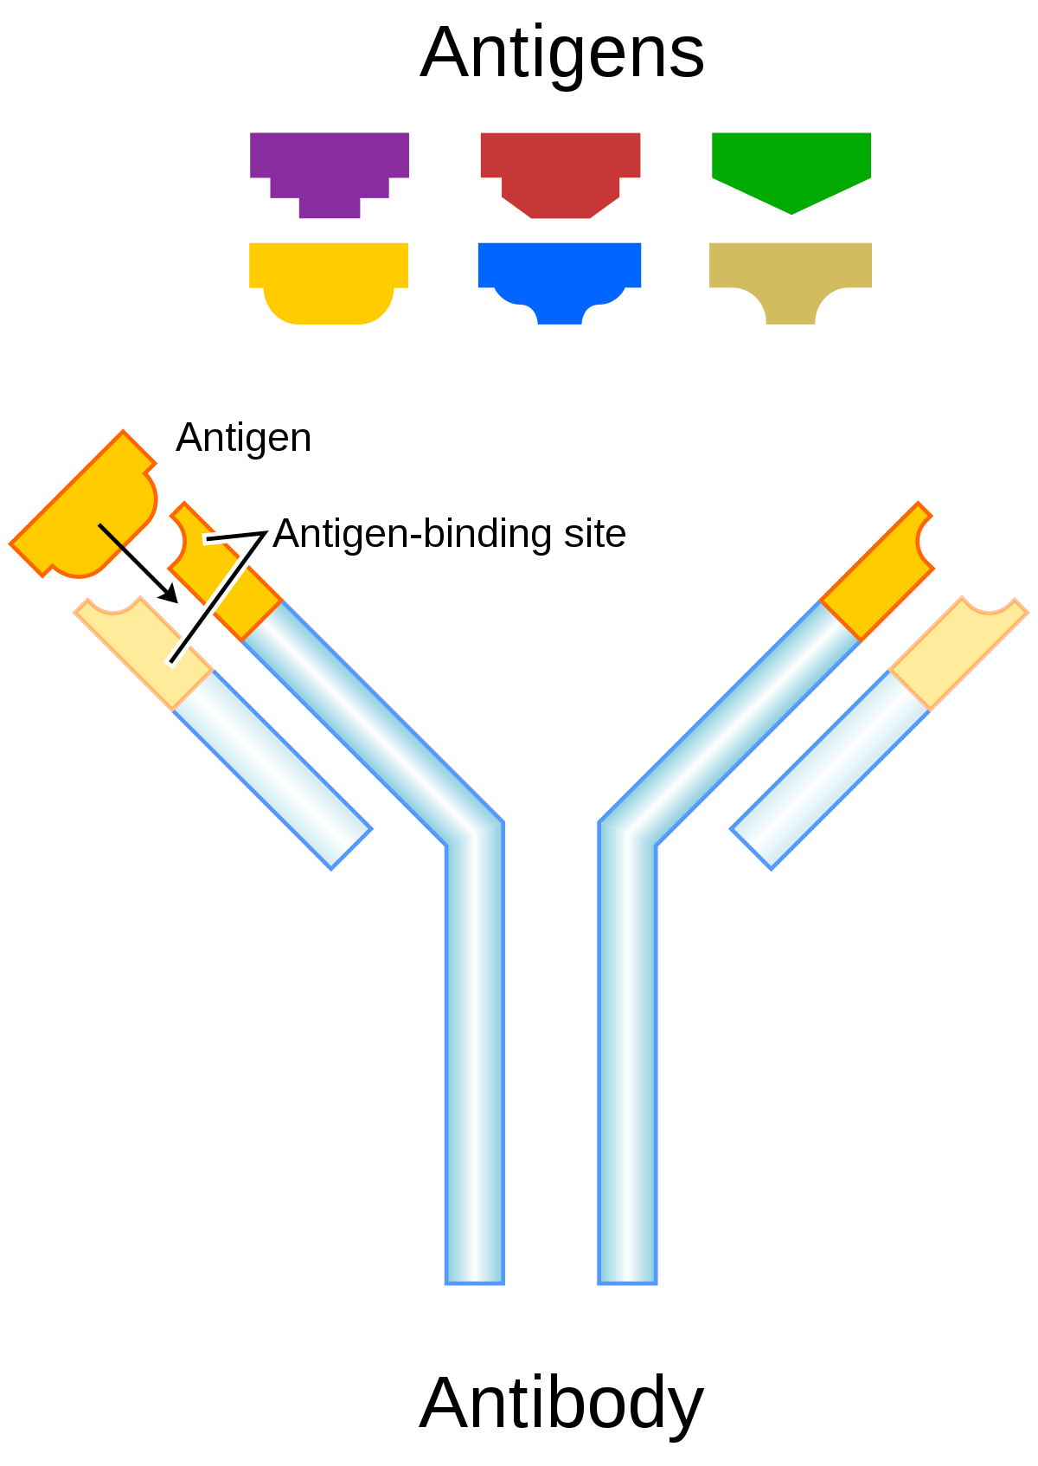
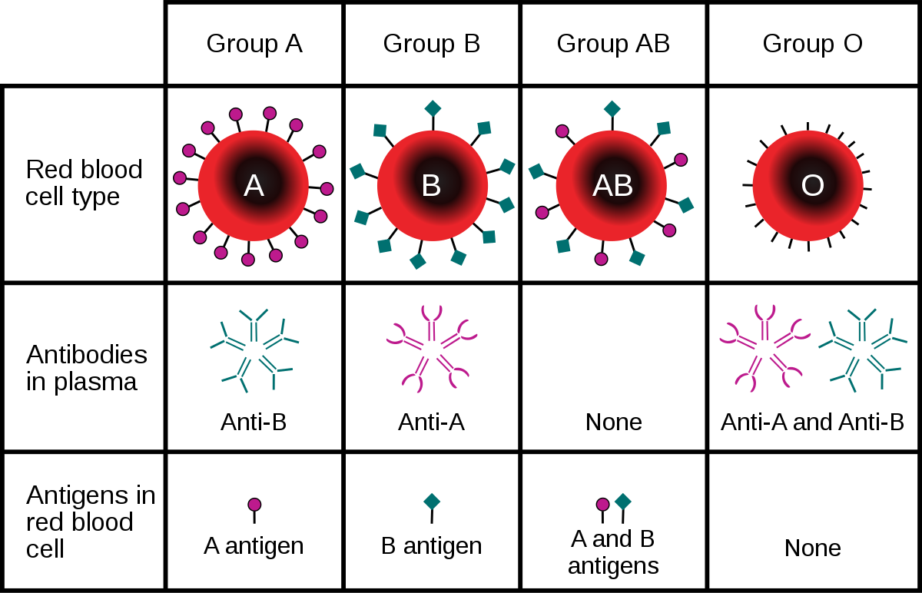
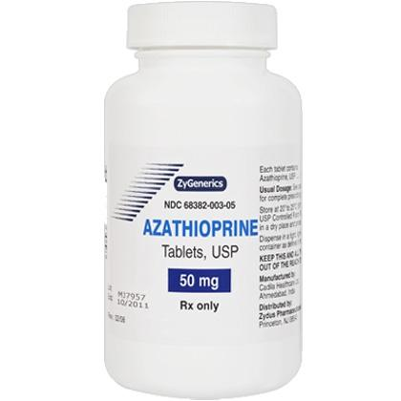
Microbiology Compatibility Discoveries

Slide 6
1960s: Transplant is now technically possible!
How are we going to get organs?

Slide 7
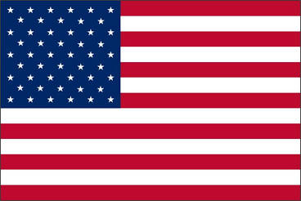
Uniform Anatomical Gift Act (UAGA) establishes
The right to make a testamentary gift, and who can make the gift
The purposes of a donation
The recipient of a donation
How to make the gift (low bar for legal validity)
Protection for acting in good faith
Means for refusal and revocation
Who cannot remove organs
Prohibition of sale/purchase of organs & tissues for Tx and Therapy
Right of state to set up a donor registry
Process for reconciling tension between Coroner/ME and OPO
Notes:
The right to make a testamentary gift, and who can make the gift
Competent adult, or authorized decision maker according to hierarchy (agent, spouse, child, parent, sibling, grandchildren, grandparents, special care or concern, guardian, authority to dispose)
System of voluntary donation would promote altruism and also protect rights of persons who might oppose donation (Dalley Clinical Anatomy 1993)
Primacy given to donor, FPA supersedes objection
The purposes of a donation
Transplant, therapy, med/dental education, research (Tx/therapy given priority)
The recipient of a donation
(a) a hospital; accredited medical school, dental school, college, or university; organ procurement organization; or other appropriate person, for research or education
(b) individual designated
(c) eye or tissue bank
How to make the gift (low bar for legal validity)
Will (but this highly restrictive (notarization, recording, filing, so UAGA provides for other less restrictive means)
Donor Card/Driver License
Donor Registry
Protection for acting in good faith
Sec 18: A person that acts in accordance with this [act] or with the applicable anatomical gift law of another state, or attempts in good faith to do so, is not liable for the act in a civil action, criminal prosecution, or administrative proceeding.
Means for refusal and revocation
Can just sign a record saying you refuse or revoke
Revocation not necessary a refusal (for ex, if you want to leave it to family)
Who cannot remove organs
Neither the physician who attends the decedent at death nor the physician who determines the time of the decedent’s death may participate in the procedures for removing or transplanting a part from the decedent.
Prohibition of sale/purchase of organs & tissues for Tx and Therapy
a person that for valuable consideration, knowingly purchases or sells a part for transplantation or therapy if removal of a part from an individual is intended to occur after the individual’s death commits a [[felony] and upon conviction is subject to a fine not exceeding [$50,000] or imprisonment not exceeding [five] years, or both][class[ ] felony]. A person may charge a reasonable amount for the removal, processing, preservation, quality control, storage, transportation, implantation, or disposal of a part.
Registry
Sec 20: The [insert name of appropriate state agency] may establish or contract for the establishment of a donor registry. (and explains requirements of registry)

Slide 8
UAGA does not
Define death (UDDA does this)
Govern living donation (NOTA, Common Law, CMS regs do this)
Cover organ allocation or matching (NOTA/OPTN does this)
Prohibit payment for bodies/parts/tissues for research & education

Slide 9
Uniform Anatomical Gift Act (UAGA) Revisions
OG 1967 / Updated: 1987; 2006/7
'67: Gift Law: MY decision
LOW bar to legal validity of donative intent
'87: Authorization Hierarchy; State Registries
'06/07: Protecting First Person Authorization from Family Veto; Managing Conflict between Advance Directive and Organ Donation

Slide 10
Principles of the UAGA
Voluntarism
Altruism
Autonomy

Slide 11
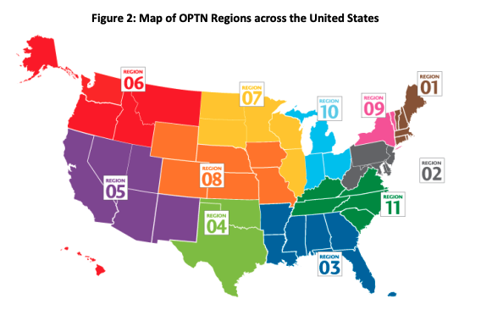
National Organ Transplantation Act (1984)
Federal law to ensure equitable allocation of donor organs
Established OPTN (under HRSA)
  Currently operated by UNOS
  Works with 56 OPOs (OPO role defined by NOTA) and over 200 Transplant Centers
Prohibits valuable consideration for parts and tissues for transplant

Slide 12
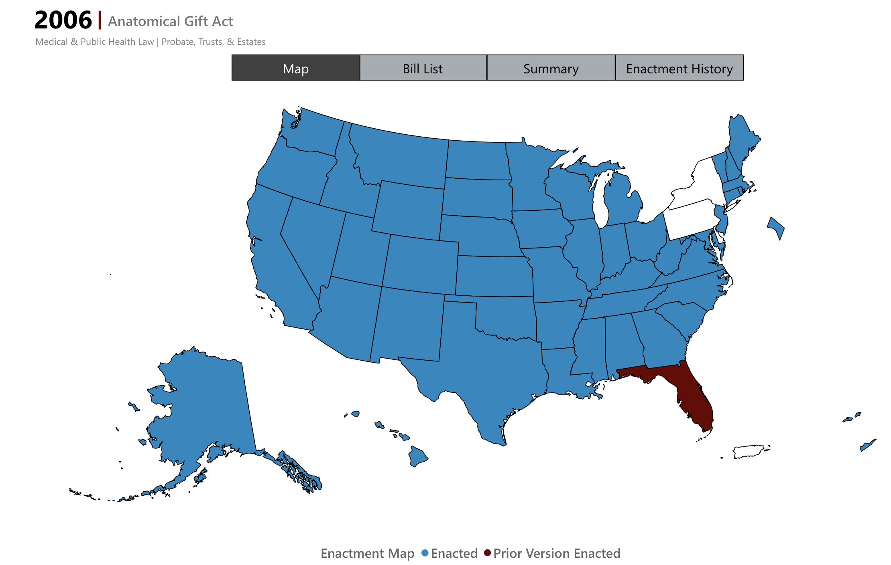
Status of UAGA
Adopted by 48 states
About 62% of eligible adults registered (more than 170 million)
More than 48,000 organ transplants performed in 2024
US consistently one of global leaders in deceased organ Tx rates
ULC, Anatomical Gift Act https://www.uniformlaws.org/committees/community-home?CommunityKey=015e18ad-4806-4dff-b011-8e1ebc0d1d0f
If it ain’t (too) broke…
Notes:
In terms of enabling organ donation, It’s working.
Not necessarily the only consideration – also have to consider what laws enable autonomous decisionmaking, and promote trust in medicine/tx.

Slide 13
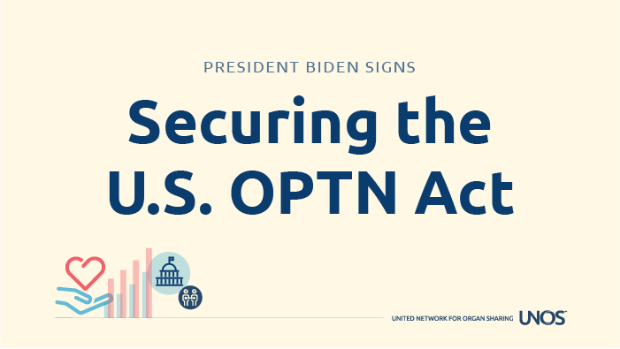
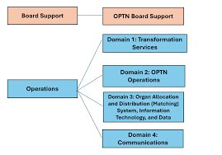
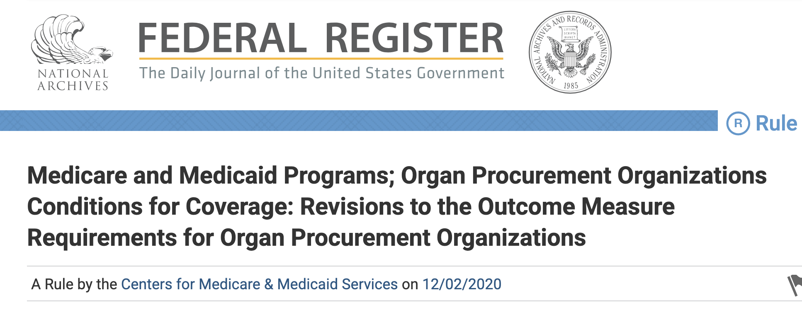
OPTN/OPOs going through massive changes
Years of concerns about lack of oversight, underperformance
Changes include:
Breaking up UNOS contract
Rebuilding OPTN governing board
Public Law No: 118-14 (Sept 22, 2023)
New OPO performance metrics

Slide 14
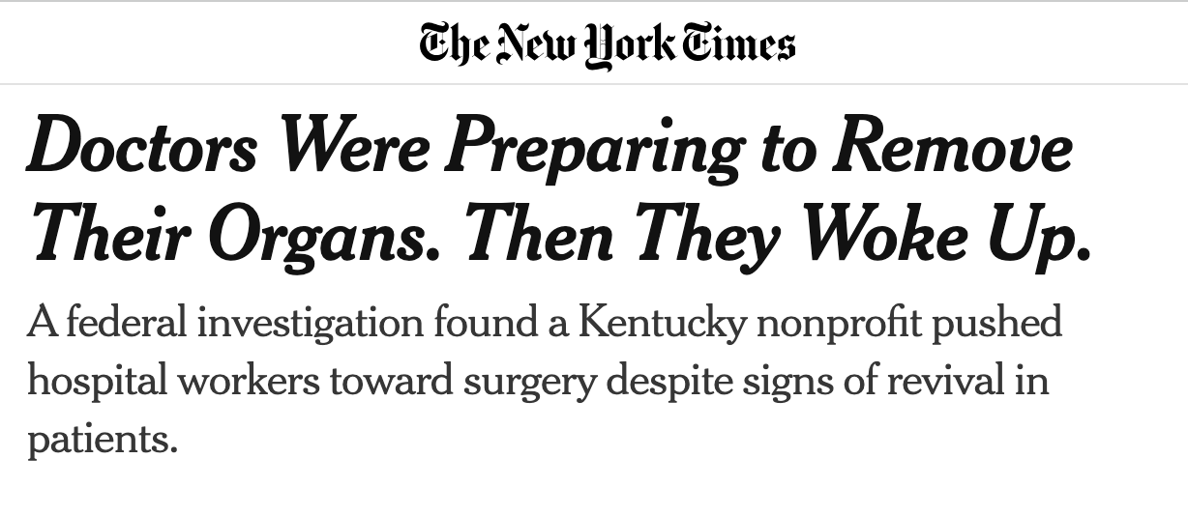
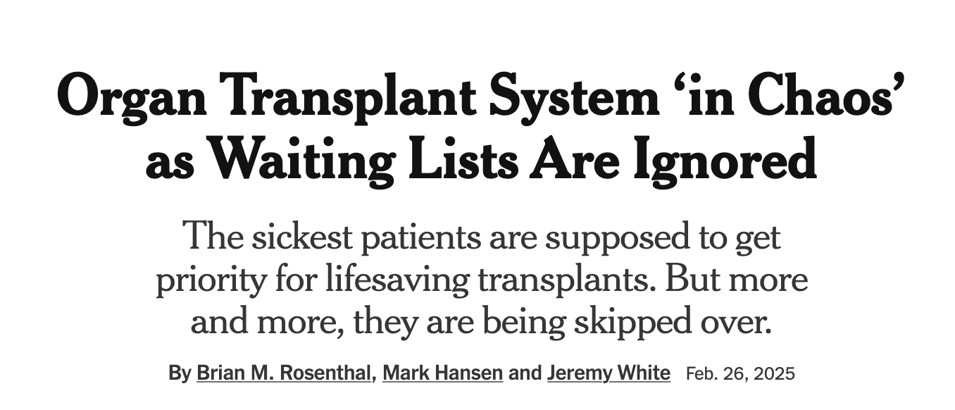
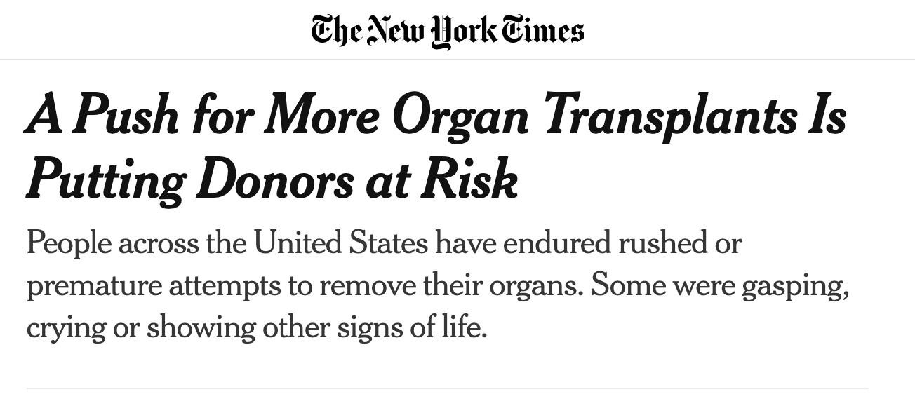
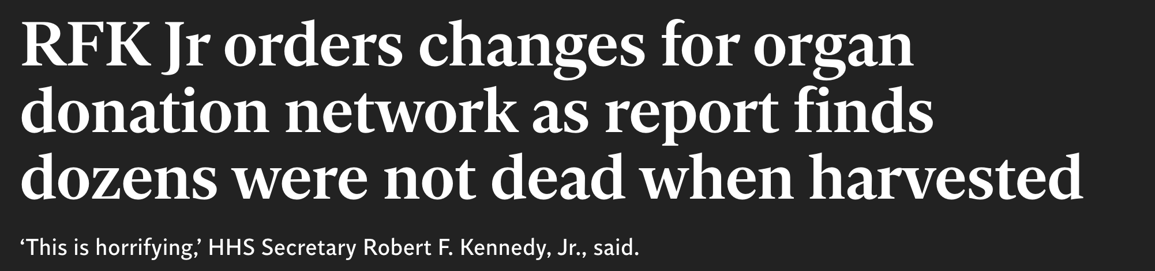
Really tough time for organ donation

Slide 15
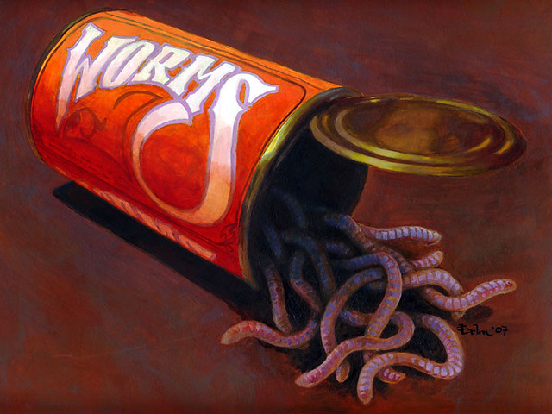

Amend the UAGA again?

Slide 16
Uniform Law Commission UAGA Study Section
Established May 2025
Topics for consideration
  Nontransplant anatomical gifts (including whole bodies)
  Posthumous gamete recovery
  Donation from unrepresented/unbefriended
Delivering recommendations to Uniform Law Commissioners June 2026

Slide 17
Donation of Nontransplant Anatomical Gifts
(including Whole Bodies, Parts, and Tissues for Research and Education)

Slide 18
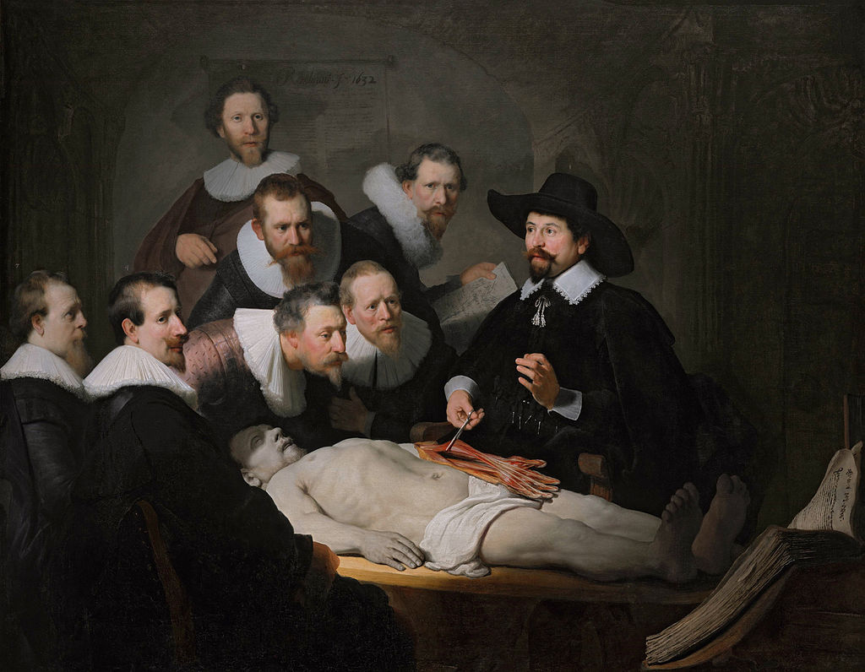
Great need for whole bodies, parts, and tissues for research and education
Notes:
For centuries, have needed bodies for anatomical dissection, for research, and medical education
As these purposes increased in frequency, needed more bodies
Body snatching, even murders, led to Anatomy Act 1832 (England), remains in force and imitated worldwide for regulating body recovery
Requires licensing for students and instructors, govt supervision, inspection, filing reports; created means for directing donation (Dalley UAGA Anatomists 1993)
Prior to UAGA, med schools relies on unclaimed bodies
Our shortage came in 1930, when gov programs subsidized funerals and unclaimed bodies could be easily claimed by friends and given burials (“friends” were often strangers hired/bribed by undertakers who wanted the business)
Every state had “anatomical laws” requiring unclaimed bodies be delivered to med schools, but there were no enforcement mechanisms

Slide 19
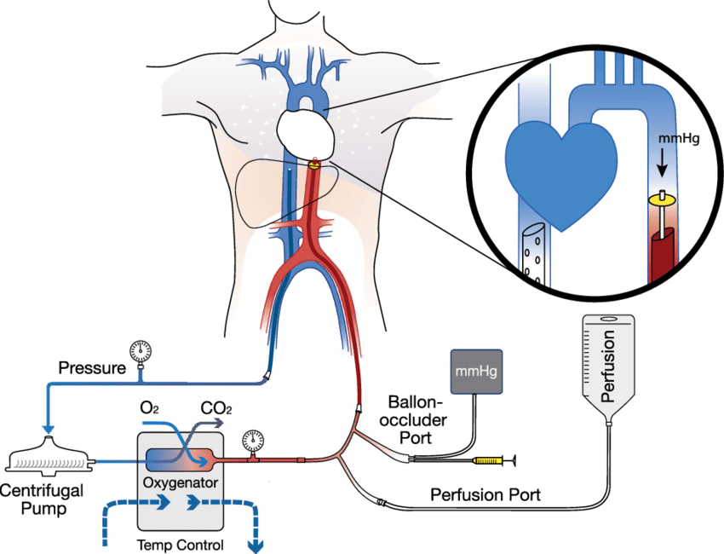
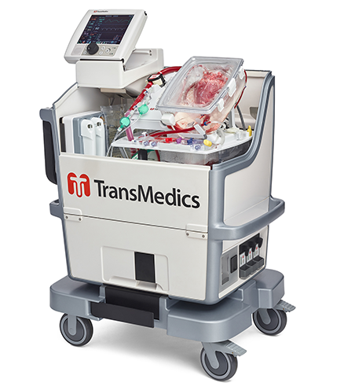
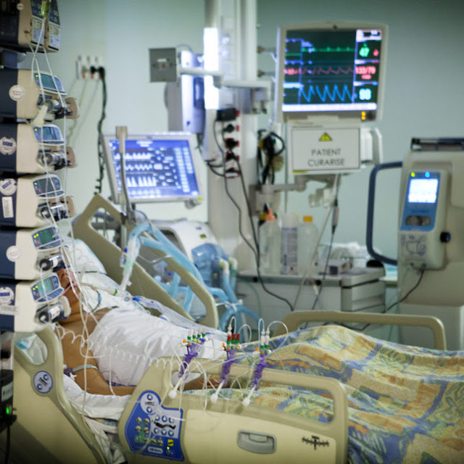
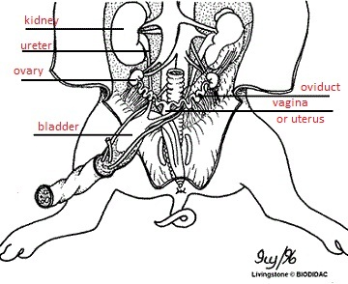
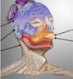
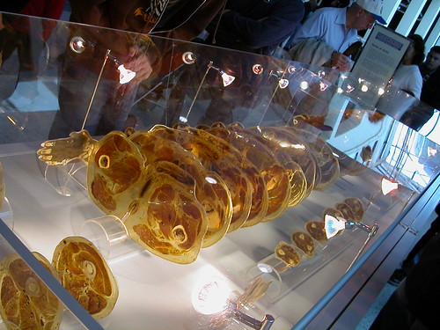
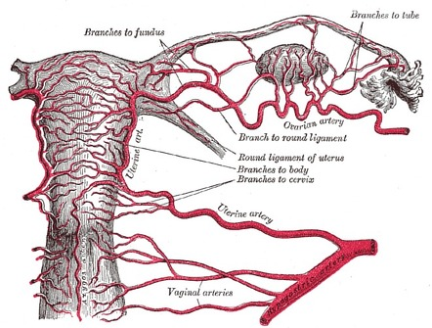
Great need for nontransplant anatomical gifts
Medical Education/surgical training
Clinical/Scientific Research
Medical Device Testing
Forensic Science/Trauma Research
Mechanically maintained deceased body research
Cadaver research and education
NYU Grossman School of Medicine, Division of Medical Ethics
Notes:
Med students learning human anatomy
Practicing Face, hand, uterus, penis transplant
Hooking pig kidneys up to perfused whole human body
Donating human brains to test stroke research
Testing gene therapy delivery across tissues
Calibrating robotic surgery devices
Testing ballistics impact

Slide 20
SECTION 16 (UAGA).
SALE OR PURCHASE OF PARTS PROHIBITED.
(a) Except as otherwise provided in subsection (b), a person that for valuable consideration, knowingly purchases or sells a part for transplantation or therapy if removal of a part from an individual is intended to occur after the individual’s death commits a [[felony] and upon conviction is subject to a fine not exceeding [$50,000] or imprisonment not exceeding [five] years, or both][class[ ] felony].
Intent: leave open possibility of tissue, part, and whole body sales for education/research. Let states decide

Slide 21
Overview of issues related to nontransplant anatomical gifts
Multibillion dollar industry
  Includes for-profit companies; non-profits; body donation programs through academic institutions
Largely self-regulated
No established national regulatory body
Exemplar Nontransplant Anatomical Donation Organizations:
  Accreditation from American Association of Tissue Banks (AATB
  Maintain strict standards for: disclosure; transport, storage, cleaning; protecting donor anonymity; disease testing; documentation; final disposition

Slide 22
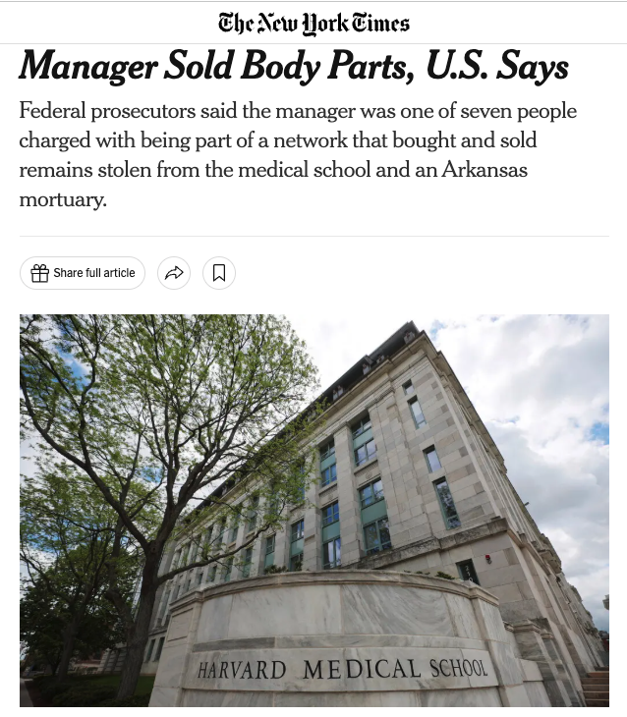
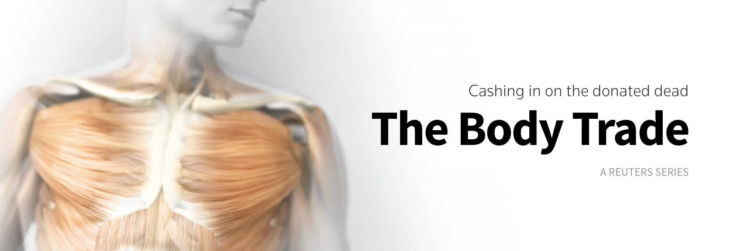
Overview of issues related to nontransplant anatomical gifts
A few bad actors cause harm and exacerbate distrust in all donation
2004-2017: 2,357 body parts obtained by NADOs from at least 1,638 people have been misused, abused or desecrated across America
2018-2022: Harvard morgue manager stole parts from cadavers that had been donated to the medical school and dissected — including heads, brains, skin and bones — before their scheduled cremations.
Notes:
2004-2017: 2,357 body parts obtained by brokers from at least 1,638 people have been misused, abused or desecrated across America (Reuters)
2018-2022

Slide 23
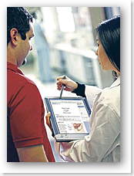
Overview of issues related to bodies, parts, tissues for research and education
Few states have requirements regarding:
  who is eligible to receive and use nontransplant gifts
  Transport, storage, and maintenance of nontransplant gifts
  Informed consent requiring specification of body uses

Slide 24

Overview of issues related to bodies, parts, tissues for research and education
Conflicts of interest operating funeral homes + Nontransplant Anatomical Donation Orgs NADOs

Slide 25

Overview of issues related to bodies, parts, tissues for research and education
No national registry for allocation

Slide 26
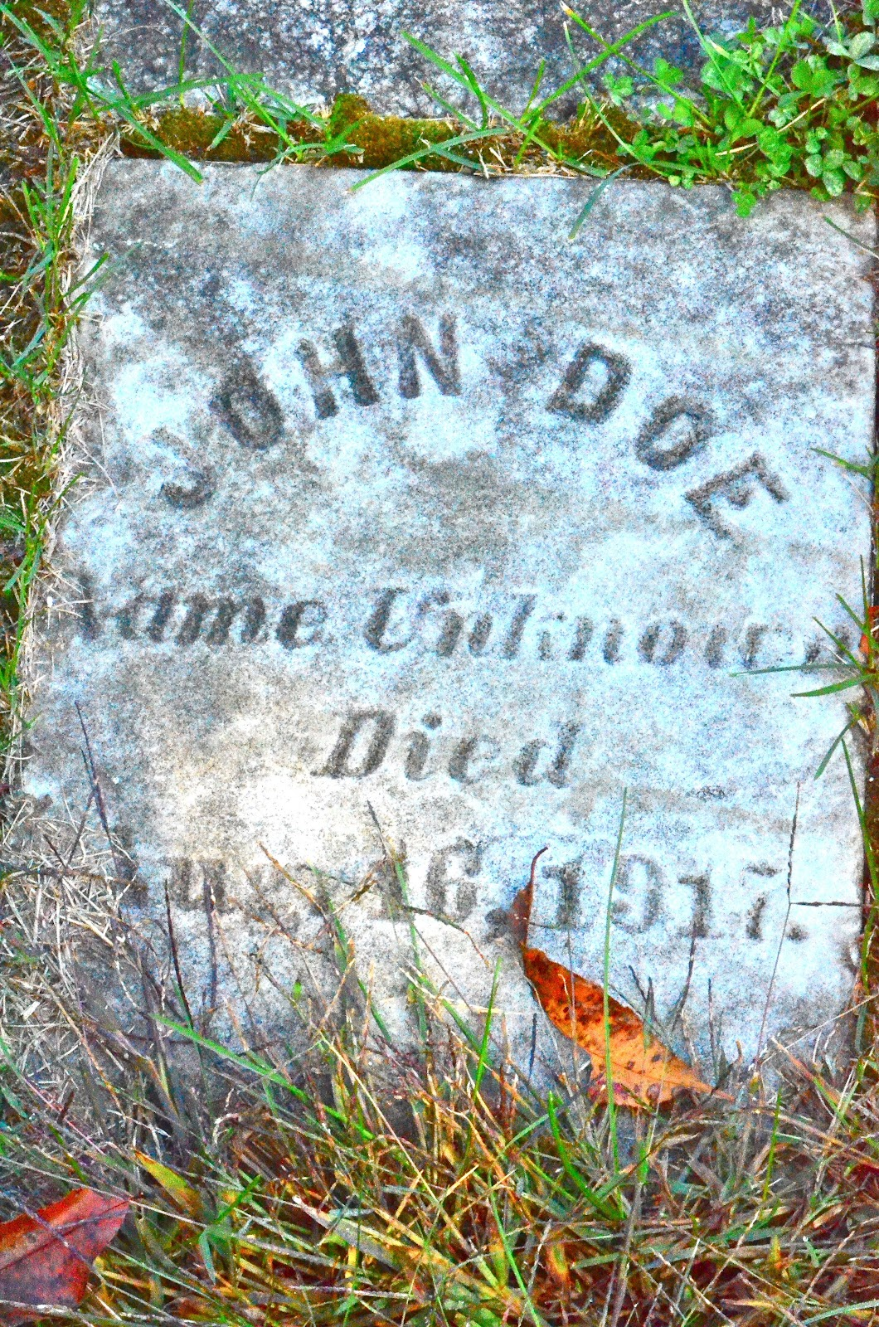
Overview of issues related to bodies, parts, tissues for research and education
Legal in most states to use unclaimed bodies for research

Slide 27
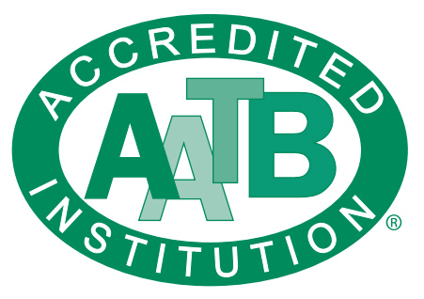
Overview of issues related to bodies, parts, tissues for research and education
Recs for ethical practice proposed by Am Assoc Clinical Anatomists, Am Assoc for Anatomy, and others
American Association of Tissue Banks (Now Association for Advancing Tissue and Biologics) used to credential NADOs, not offering new credentials
Some NADOs have internal oversight committees, some have ethics review process
Notes:
AATB publishes the Standards for Tissue Banking, which is widely recognized as the definitive guide for best practices in recovering, processing, and distributing human tissue
It represents over 1,000 tissue establishments and thousands of individual professionals, working to promote tissue donation and ensure a safe, sufficient supply of transplantable allografts (such as bone, skin, tendons, and corneas)
The AATB Board of Directors finalized a major transition to align the association exclusively with establishments involved in the manufacturing of human tissue for transplantation. As a result, the AATB is no longer recognizing NADOs as institutional members, has dissolved the NADO Council, and has stopped accepting new NADO accreditations

Slide 28
Examples of Relevant State Laws and Federal Proposals
10 CRR-NY 52-11.3 Requires documented informed consent, including specific uses
Ariz Rev Stat 36-850/851: Requires licensing by DHS; defines appropriate recipients; consent forms; donor tracking; documentation; etc
Co Rev Stat 12-140-105.4: Cannot have large stake in both funeral home business and nontransplant tissue bank
Tex. HSC 691(2025) Ensuring Dignity for the Deceased: informed consent, prior auth required for unclaimed bodies; state licensing required; enforced by Tex Funeral Service Commission
H.R.2589/S.1270 (2025) Consensual Donation and Research Integrity Act (stalled in Committee)
Massive state variation, limited enforcement
Notes:
10 CRR-NY 52-11.3
(a) Nontransplant anatomic banks that recover bodies, body segments, organs or tissues from deceased donors, including whole body acquisition services, shall obtain documented informed consent to the donation from a person authorized to consent to such donation.
(d) The documentation of informed consent to a donation shall identify the donee, indicate whether the gift is of the whole body or is limited to specified identifiable body segments, organs or tissues, and clearly specify the authorized uses of such donated body, body segments, organs, and/or tissues.
Consensual Donation and Research Integrity Act: to protect the dignity of those who donate their bodies to education or research.
Would create standards for registration, inspection, chain of custody, labeling and packing, and proper disposition.
Would create a registration and tracking system for bodies and body parts donated for research, thus preventing body brokers and bad actors from taking advantage of donors and donor families.
In almost every state, it remains legal to sell the human remains of adults, and worse, under current law, almost anyone — regardless of expertise — can dissect and sell human body parts. Because of this, grisly abuses of donor bodies abound.
Supported by National Funeral Directors Association
In first stage of legislative process, low current chance of being enacted
Ensuring Dignity for the deceased:
prohibits the donation of unclaimed bodies to willed body programs, non-transplant anatomical donation organizations, or other entities for medical research unless a written directive from the deceased or informed consent from a legally authorized person is filed with the proper authorities.
Pending in Senate Health and Human Services Committee
Protecting the Dignity of Donated Human Remains

Slide 29
Nontransplant anatomical donations: considerations for UAGA amendment
Should there be requirements regarding:
Do we need a new uniform act?
  Recipient qualifications (who gets to receive such gifts)
  Facility licensing and director credentials
  Reasonable costs and fee limitations
  Donor anonymity
  Informed consent
  Transport, storage, maintenance, cleaning
  disease testing
  Use of unclaimed bodies
  Final disposition of remains

