Slide 1
Upholding Appropriate Prescribing Standards on Telemedicine Platforms
Katherine Drabiak, JD
Professor
Department Chair, Health Policy & Systems Management
College of Public Health
University of South Florida
kdrabiak@usf.edu
June 2026

Slide 2
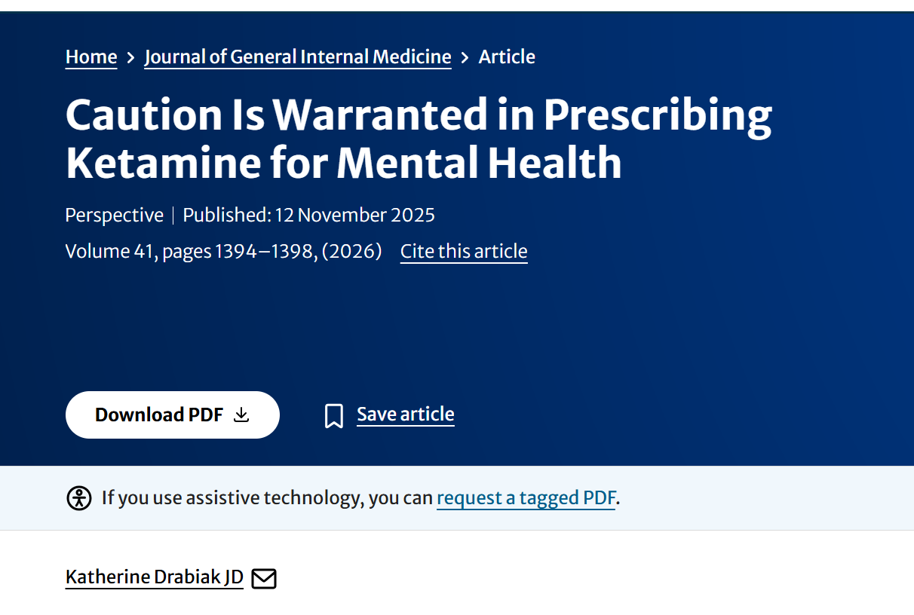
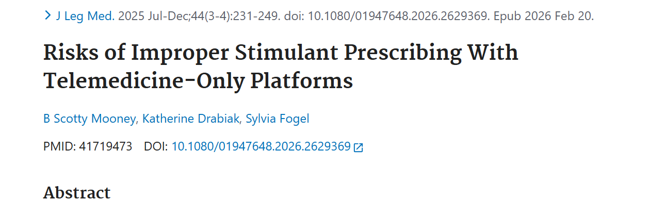
Two Articles
Notes:
cardiovascular side effects and bone mineral density
Wyman notes that this reduces a provider’s ability to observe physical cues, such as the patient’s appearance, body language, demeanor, and how each of these factors change over time.93Effective care requires connection, building trust, and establishing rapport with the patient, which may be reduced with a virtual only forum.94

Slide 3
Overview
Growth of telemedicine-only platforms
State law prescribing
Prescribing for a legitimate medical purpose
Changes in federal law

Slide 4



Growth of Telemedicine-Only Platforms
Telehealth platforms are designed to maximize consumer engagement with a marketing message, which differs from the aim of providing clinically accurate information to patients.
How it works
Financial incentives
Theoretical benefits
Stimulants
Ketamine
Notes:
Theoretical benefits
-affordable, convenient, accessible, shorter wait times
Online advertising: seek treatment and obtain medication fully online
Direct advertisements to patients
Telehealth platforms are designed to maximize consumer engagement with a marketing message, which differs from the aim of providing clinically accurate information to patients.
How it works: questionnaire, brief virtual visit, fee or subscription, may obtain a prescription

Slide 5

Changes in Federal Law
Key Requirements
Legitimate medical purpose;
Within the scope of professional practice;
Provider conducts at least one in-person medical evaluation of the patient; and
Provider must comply with federal and state laws
4 temporary rules
2025 Notice of Proposed Rulemaking for Special Registration Process
Permanently eliminate the in- person exam requirement
Notes:
temporary rule states that providers must conduct the initial appointment using real- time, two-way audiovisual equipment.30The DEA has extended this temporary rule four times, in effect until December 2026
In 2025, the DEA issued a Notice of Proposed Rulemaking, which would create a special registration process, which includes heightened recordkeeping and reporting requirements and requirements to check the prescription drug monitoring database across all states, and would permanently eliminate the requirement for an in-person exam for certain telemedicine providers.34

Slide 6
Key Components of State Laws
State prescribing requirements
Legitimate medical purpose
Within the scope of professional practice
State licensure
Initial waivers and Executive Orders
Amendments: one license sufficient
PDMPs
Variation in use and query patterns
Limited mandates
Limited drugs included
Oversight by state medical boards
Potential Administrative Sanctions
Accedes to patient request for a specific Rx
Knows Rx will be used for nontherapeutic purpose
Permits repeated refills over short time
Cursory exam
Prescribes similar Rx to virtually every patient
Does not fully evaluate patient symptoms
Notes:
Prescribing for legitimate medical purpose (to treat a diagnosed condition or illness) and prescribing within the scope of professional practice (other providers would prescribe in this manner)
multiple states waived this requirement, allowing providers to treat patients who reside in states where the provider is not licensed
Some states recently amended their law or issued executive orders, allowing providers to treat patients in the state as long as the provider is licensed in another state.
considered factors such as whether the physician accedes to patient requests for specific medications; knows the patient intends to use the medication for nontherapeutic purposes; permits repeated refill requests over a short period of time; does not fully inquire about the basis of patient symptoms; does not schedule follow-up appointments to assess patient progress; and/or prescribes similar medications to virtually every patient.

Slide 7
Expanded Prescribing
Cosmetic prescribing
Not merely treating illness
Energy
Focus
Weight loss
Concentration
Improved mood
Facilitate patients’ subjective happiness
Enhanced well being
Should be able to experience drug-induced altered states of consciousness
Prescribing parameters in state law
Narrow diagnostic criteria (some states)
Therapeutic necessity
What constitutes a legitimate medical purpose?
Notes:
Cosmetic or enhancement prescribing – increased energy, focus, concentration, weight loss, improved mood.
Not only treating illness, but promoting social functioning, well being, subjective happiness.
“legitimate medical
purpose” should encompass facilitating patients’ subjective
happiness through using controlled substance
should be able to experience drug-induced
altered states of consciousness
Providers should be aware that some state regulations may specify only narrow diagnostic indications when prescribing certain types of controlled substances such as stimulants, which would preclude expansive or enhancement prescribing.44Importantly, multiple courts have upheld the decision of state medical boards to suspend or revoke physician licenses for wrongful prescribing in cases where a physician prescribed controlled substances without specifying the therapeutic necessity, where the physician did not demonstrate the medication was medically necessary, or when physicians prescribed stimulants for a nonmedical reason (including prescribing controlled substances to lose weight or to stay awake longer

Slide 8
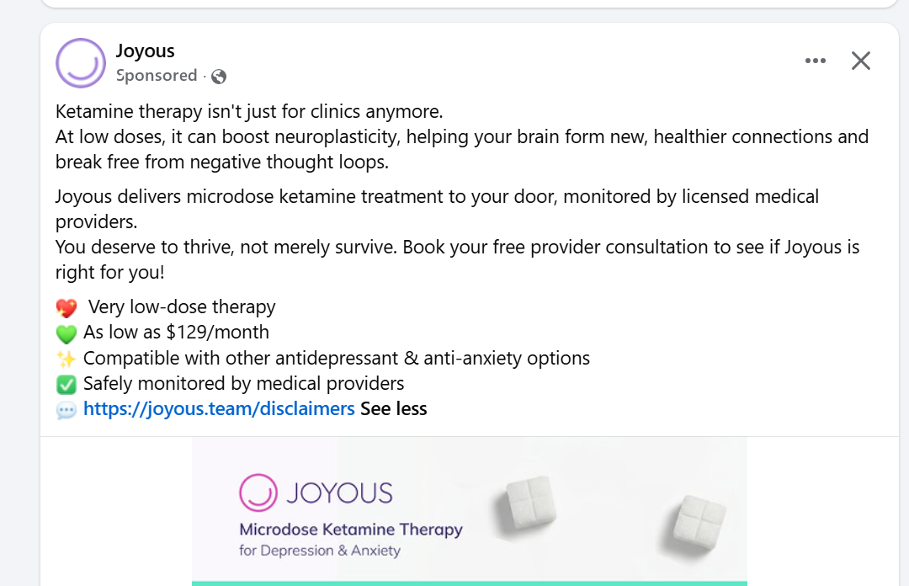
Marketing Claims
Telemedicine companies may advertise off label uses
Claims may not be false or misleading
Only 41% of clinics disclosed adverse effects of ketamine on their websites, including the risk of misuse and addiction (Crane et al. 2023)
Telehealth advertisements are marketing claims
designed to induce customers to purchase a product or
service. Here, this means convincing the public to become telehealth customers—by becoming a patient and obtaining a prescription—while downplaying risks.
Notes:
Unlike pharmaceutical companies, not bound by restrictions on off label marketing, or marketing for purposes beyond the approved clinical indication.
Although federal law prohibits
drug manufacturers from marketing off-label uses of ketamine
and suggesting its benefits to mental health, no similar
prohibition applies to telehealth corporations. Accordingly,
it is legally permissible for telehealth corporations
to promote and sell their product—the benefits of ketamine—
as long as their claims are not false or misleading.
Telehealth advertisements are marketing claims
designed to induce customers to purchase a product or
service. Here, this means convincing the public to become
telehealth customers—by becoming a patient and obtaining
a prescription—while downplaying risks.

Slide 9
Risks to Patients
Narrows the clinical encounter
Rule out other conditions
Serious risks
56.3% report using stimulants to maintain alertness or concentrate, 21.9% to help them study or work, 15% to experiment or get high, and 4.1% to manage weight (Compton et al. 2018)
Check for contraindications
Limited monitoring of physical symptoms
Focuses on pharmacological treatment
Misuse or diversion
Taking as prescribed: limited (or no) drug screens
More transactional, less personal
More difficult to establish connection, trust, rapport
16–29% of patients with a stimulant prescription were asked to sell, give away, or trade the drug (Uscher-Pines et al. 2024)
Visual and environment cues
Quality and safety
Inherent safety profile
Risk of dependence
Patient reported use patterns for ketamine: designed to impair and incapacitate
Notes:
cardiovascular side effects and bone mineral density
Wyman notes that this reduces a provider’s ability to observe physical cues, such as the patient’s appearance, body language, demeanor, and how each of these factors change over time.93Effective care requires connection, building trust, and establishing rapport with the patient, which may be reduced with a virtual only forum.94

Slide 10
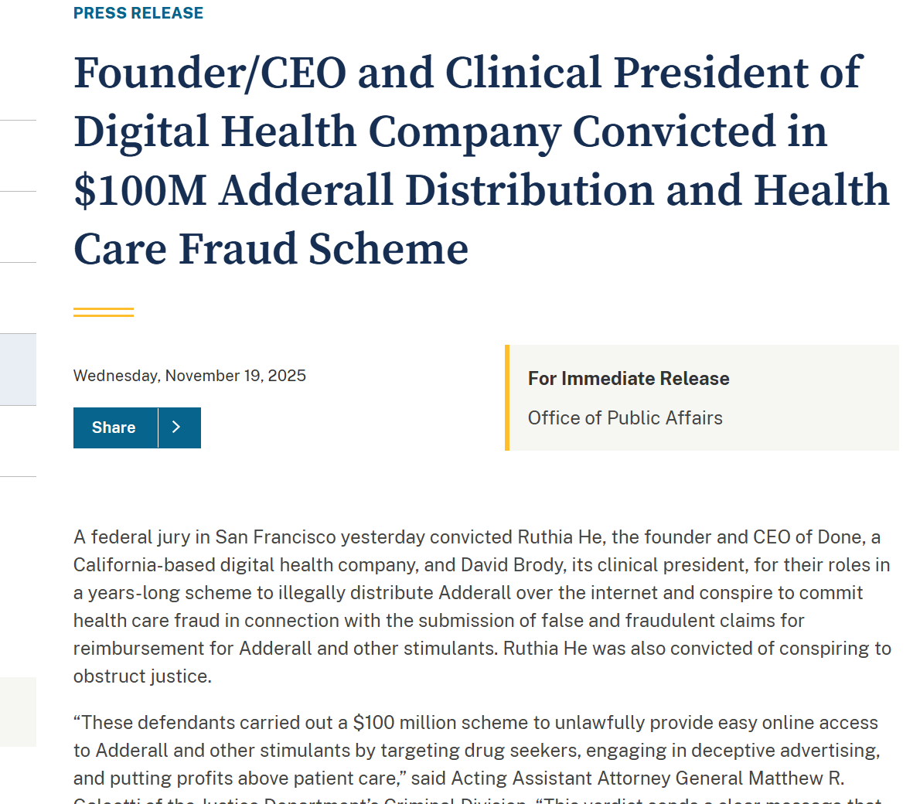
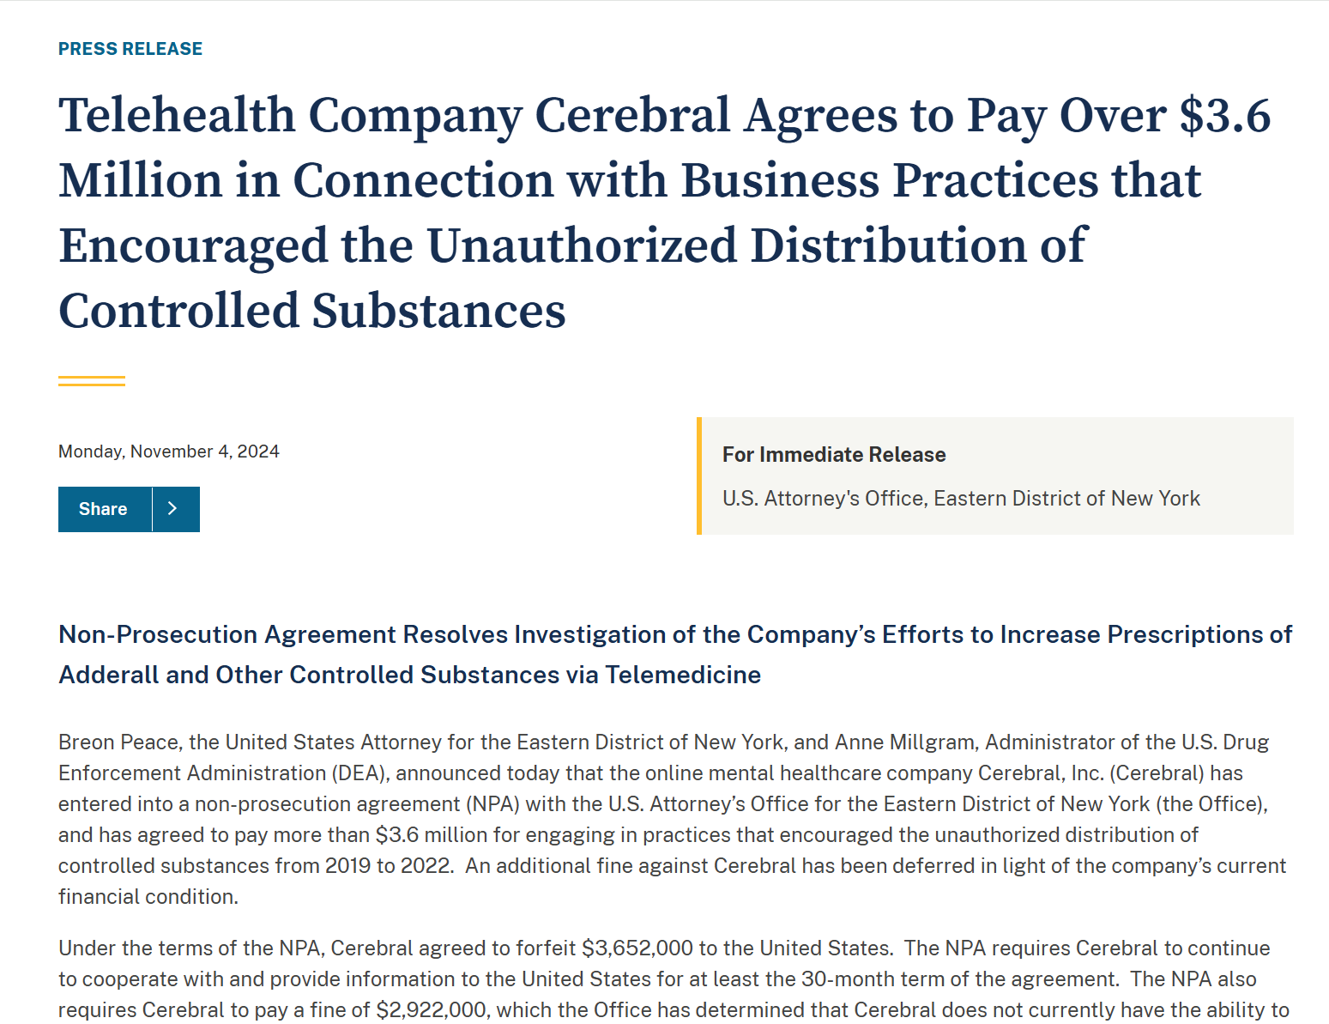
Risks to Providers
Administrative sanctions and licensure
Civil liability
Criminal liability
Notes:
Criminal actions against providers and telehealth corporations occur only when they knowingly and intentionally acted outside their authority to prescribe controlled substances.114Ruan v. U.S. clarified that mistaken, negligent, or careless prescribing is not sufficient to support criminal charges.115Rather, physicians may face criminal liability for wrongfully prescribing controlled substances when they used their prescribing authorization as a physician as subterfuge for a prescription selling model.116If physicians abandon their role as trusted fiduciaries and begin to act as “drug traffickers” where they operate for profit over patient benefit, this may result in criminal culpability.
Done Global
federal drug trafficking, conspiracy in drug trafficking, and fraud
DOJ alleges that He structured the business so that providers would prescribe stimulants even if the patient did not qualify and mandated that initial encounters should be under 30minutes.120To maximize profits, He allegedly put in a place an “auto-refill” function and discouraged follow-up appointments by structuring payments to providers based on the number of patients who received prescriptions, while declining to pay providers for virtual visits, consultations, or follow-ups.121This allegedly also resulted in providers issuing fraudulent prescriptions that were not medically indicated, resulting in fraud against commercial insurance companies, Medicare, and Medicaid totaling $14,000,000.122Internal Revenue Service (IRS) criminal investigations reports that this resulted in profits of more than $100,000,000, but led patients to “addiction, abuse, and overdose.”123
In November 2025, a federal jury convicted He and Brody of criminal violations including conspiracy to distribute controlled substances, illegal distribution of controlled substances, and conspiracy to commit health care fraud.124The jury also convicted He for conspiracy to obstruct justice. During the investigation, He moved operations to China, destroyed evidence, and funneled corporate profits to a shell company.
Cerebral INC
In November 2024, the U.S. Attorney’s Office for the Eastern District of New York approved a non-prosecution agreement with Cerebral, Inc.1
DOJ investigated Cerebral, Inc., finding violations of federal drug laws, including drug trafficking, and conspiracy in drug trafficking.
-non-prosecution agreement, Cerebral, Inc., agreed to stipulate multiple findings about its business practices.
-one executive explained that the quality improvement plan was to eventually reach a “near 100%” metric for prescribing stimulants to all patients with -providers would receive additional compensation for each prescription, and bonuses were tied to the amount of stimulant prescriptions they issued.
-providers were “underperformers” and did not meet the prescribing metric, they would be issued disciplinary warnings, receive “re-education” training, and get flagged.
-some providers did raise concerns about prescribing practices, asserting that some patients appeared to be drug seeking and that it was questionable whether other patients seeking medication actually had ADHD
- insufficient mechanisms to address diversion, noting that one patient had multiple accounts and was receiving duplicate prescriptions from multiple providers within Cerebral, Inc.
- As part of the non-prosecution agreement, Cerebral, Inc., modified several business practices, agreed to stop prescribing stimulants (it still prescribes other controlled substances), and must pay a forfeiture amount of $3,652,000.00 (revenue of inappropriate prescriptions attributed to violation of federal drug trafficking laws) and a monetary penalty of $2,922,000.00.134

Slide 11
Takeaway Points
Removing in-person requirement likely permanent for federal law
Controlled substances entails significant risks to patient safety with less monitoring
Professional obligations to patient safety and quality of care should guide prescribing practices and business models
State law requirement for a “legitimate medical purpose” precludes cosmetic prescribing
Risk/liability for providers and business models that maximize prescribing without medical indication or sufficient oversight

Slide 12
Questions?
Katherine Drabiak, JD
Professor
Department Chair, Health Policy & Systems Management
College of Public Health
University of South Florida
kdrabiak@usf.edu

